Slide 1
Compare Sampler voltage from gain cal vs ideal

Slide 2
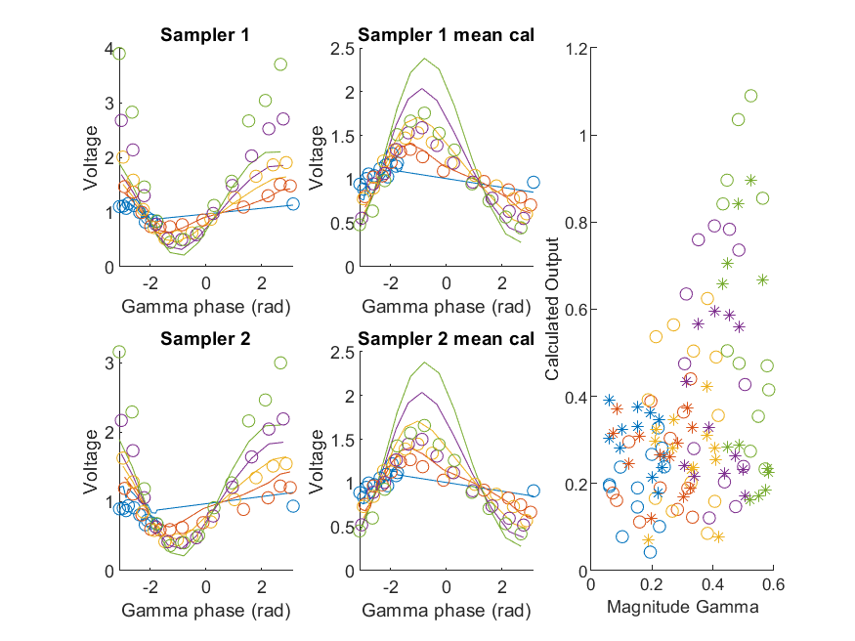
Coupled Line Performance At 10.60 GHz, 16.000000 dBm Output Power 1.00 V mean sampler bias
Sampler Av
Sampler 1: 6.4e-06
Sampler 2: 1.1e-05
Sampler 1 linear: 7.9e-06
Sampler 2 linear: 1.1e-05
Sampler Offset
Sampler 1: 0.0084
Sampler 2: 0.009
RMSE
Linear: 0.63
Individual: 0.68

Slide 3
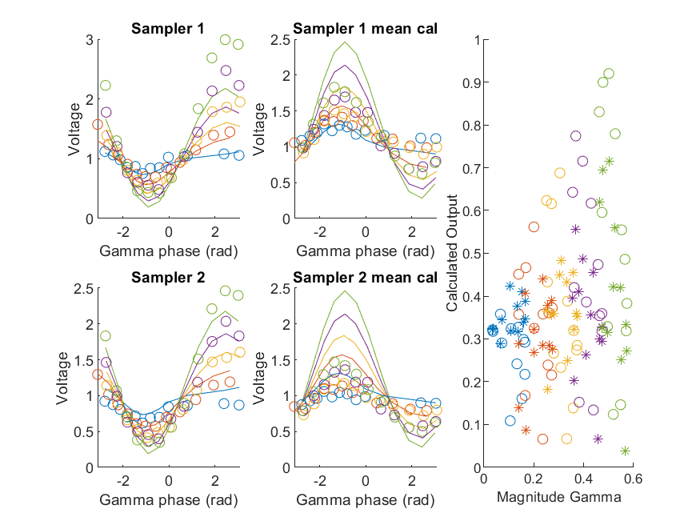
Coupled Line Performance At 10.70 GHz, 16.000000 dBm Output Power 1.00 V mean sampler bias
Sampler Av
Sampler 1: 6.5e-06
Sampler 2: 1.2e-05
Sampler 1 linear: 7.9e-06
Sampler 2 linear: 1.4e-05
Sampler Offset
Sampler 1: 0.0084
Sampler 2: 0.009
RMSE
Linear: 0.62
Individual: 0.63

Slide 4
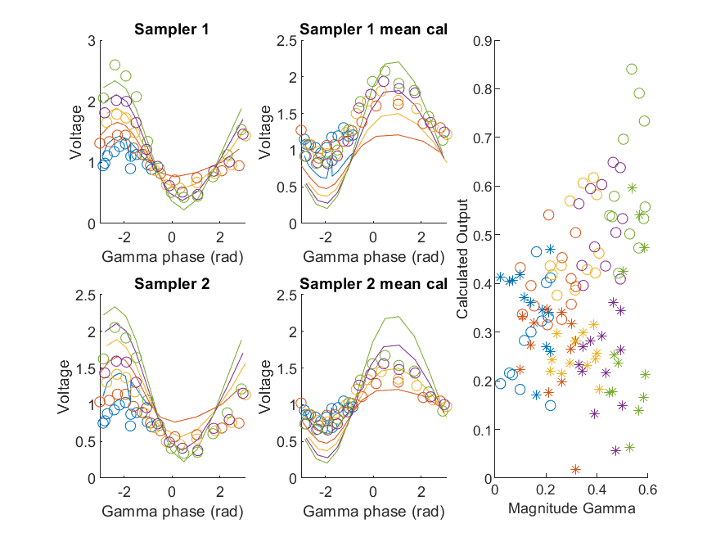
Coupled Line Performance At 10.80 GHz, 16.000000 dBm Output Power 1.00 V mean sampler bias
Sampler Av
Sampler 1: 6.8e-06
Sampler 2: 1e-05
Sampler 1 linear: 8.6e-06
Sampler 2 linear: 1.3e-05
Sampler Offset
Sampler 1: 0.0084
Sampler 2: 0.009
RMSE
Linear: 0.53
Individual: 0.63

Slide 5
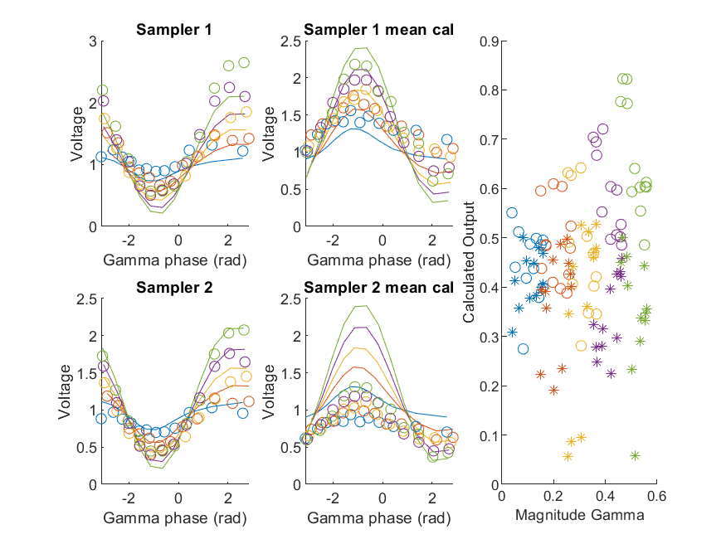
Coupled Line Performance At 10.90 GHz, 16.000000 dBm Output Power 1.00 V mean sampler bias
Sampler Av
Sampler 1: 6.9e-06
Sampler 2: 9.1e-06
Sampler 1 linear: 8.8e-06
Sampler 2 linear: 1.5e-05
Sampler Offset
Sampler 1: 0.0084
Sampler 2: 0.0089
RMSE
Linear: 0.61
Individual: 0.65

Slide 6
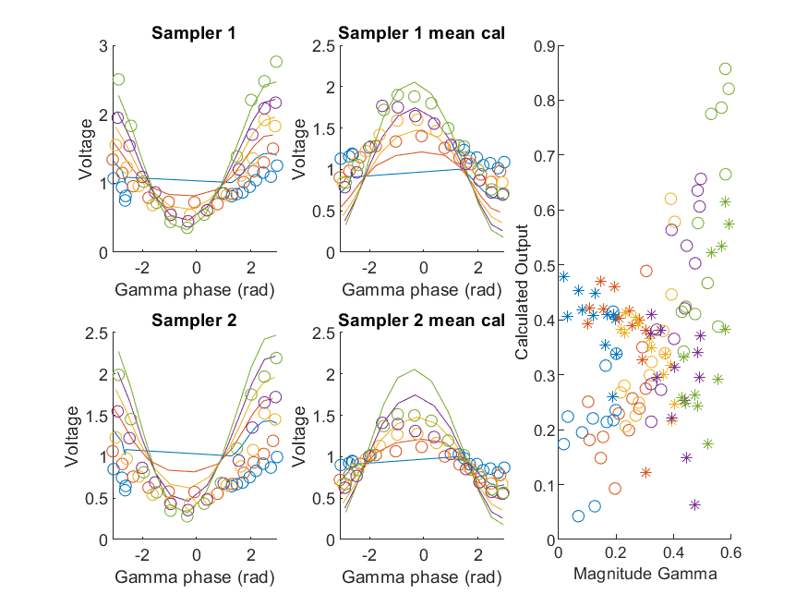
Coupled Line Performance At 11.00 GHz, 16.000000 dBm Output Power 1.00 V mean sampler bias
Sampler Av
Sampler 1: 7.5e-06
Sampler 2: 1e-05
Sampler 1 linear: 9.4e-06
Sampler 2 linear: 1.2e-05
Sampler Offset
Sampler 1: 0.0084
Sampler 2: 0.009
RMSE
Linear: 0.56
Individual: 0.64

Slide 7
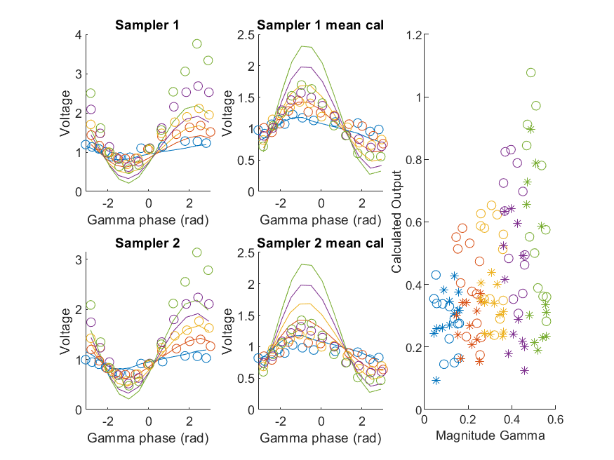
Coupled Line Performance At 11.10 GHz, 16.000000 dBm Output Power 1.00 V mean sampler bias
Sampler Av
Sampler 1: 5.9e-06
Sampler 2: 1.2e-05
Sampler 1 linear: 7.1e-06
Sampler 2 linear: 1.5e-05
Sampler Offset
Sampler 1: 0.0084
Sampler 2: 0.009
RMSE
Linear: 0.61
Individual: 0.67

Slide 8
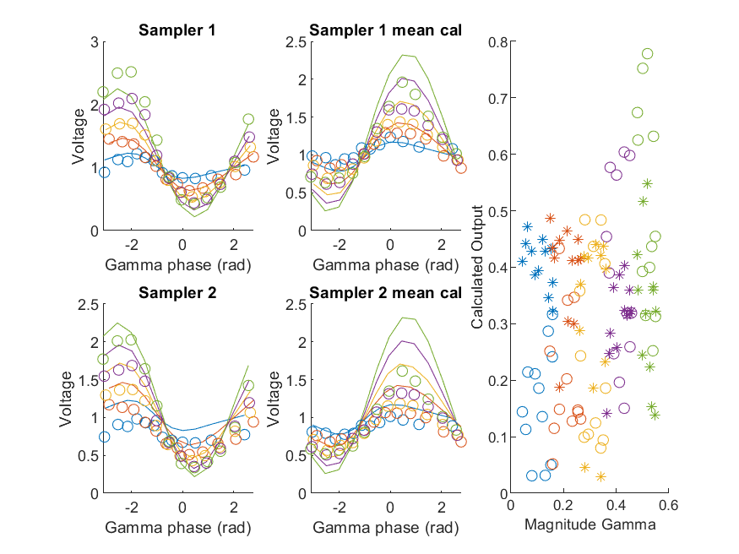
Coupled Line Performance At 11.20 GHz, 16.000000 dBm Output Power 1.00 V mean sampler bias
Sampler Av
Sampler 1: 7.7e-06
Sampler 2: 1.1e-05
Sampler 1 linear: 9.5e-06
Sampler 2 linear: 1.4e-05
Sampler Offset
Sampler 1: 0.0084
Sampler 2: 0.009
RMSE
Linear: 0.53
Individual: 0.53

Slide 9
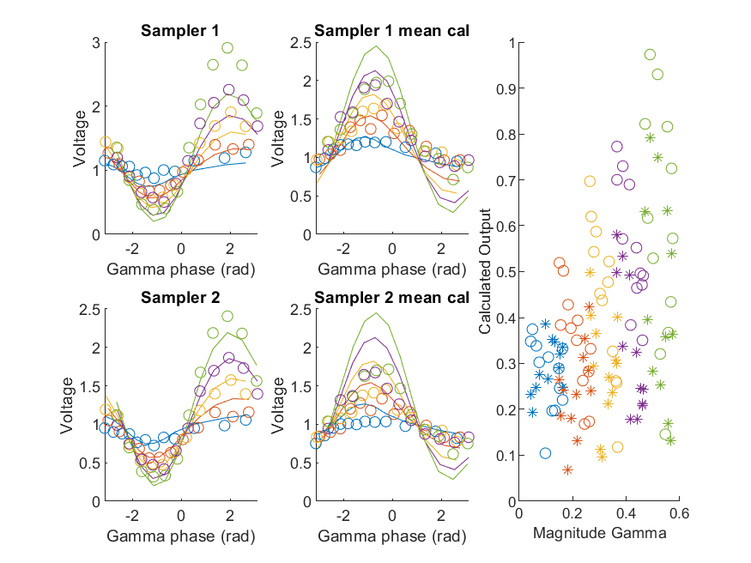
Coupled Line Performance At 11.30 GHz, 16.000000 dBm Output Power 1.00 V mean sampler bias
Sampler Av
Sampler 1: 7.9e-06
Sampler 2: 1.1e-05
Sampler 1 linear: 9.6e-06
Sampler 2 linear: 1.2e-05
Sampler Offset
Sampler 1: 0.0084
Sampler 2: 0.009
RMSE
Linear: 0.54
Individual: 0.59

Slide 10
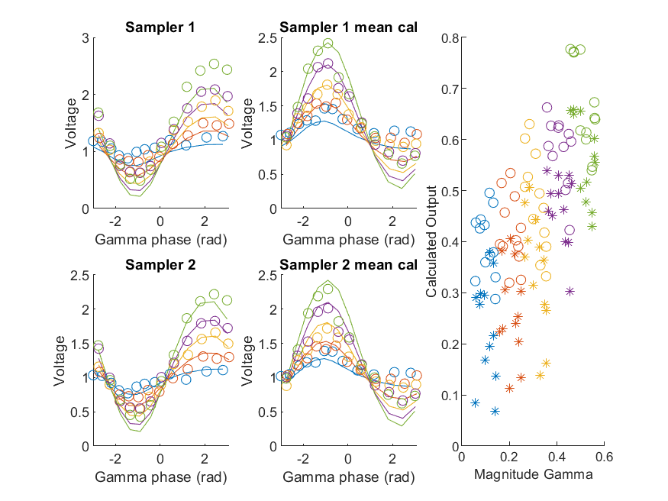
Coupled Line Performance At 11.40 GHz, 16.000000 dBm Output Power 1.00 V mean sampler bias
Sampler Av
Sampler 1: 8.4e-06
Sampler 2: 1.1e-05
Sampler 1 linear: 9.6e-06
Sampler 2 linear: 1.2e-05
Sampler Offset
Sampler 1: 0.0084
Sampler 2: 0.009
RMSE
Linear: 0.53
Individual: 0.63

Slide 11
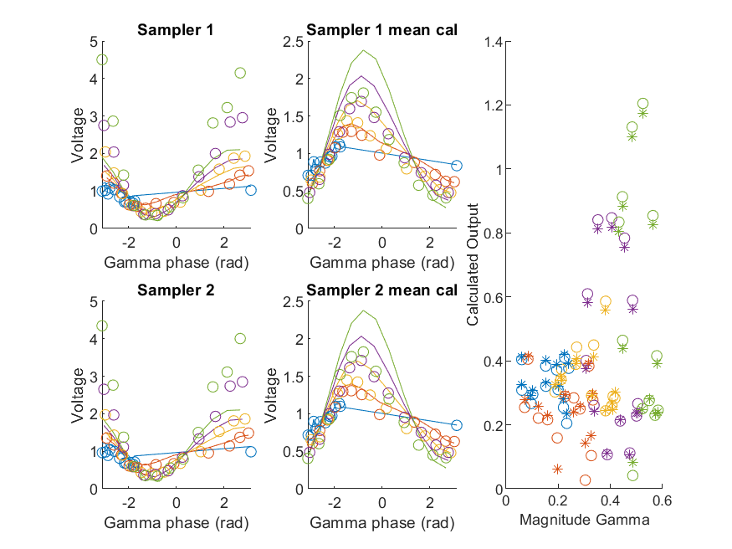
Coupled Line Performance At 10.60 GHz, 18.000000 dBm Output Power 1.00 V mean sampler bias
Sampler Av
Sampler 1: 7.6e-06
Sampler 2: 1.2e-05
Sampler 1 linear: 7.9e-06
Sampler 2 linear: 1.1e-05
Sampler Offset
Sampler 1: 0.0084
Sampler 2: 0.009
RMSE
Linear: 0.69
Individual: 0.7

Slide 12
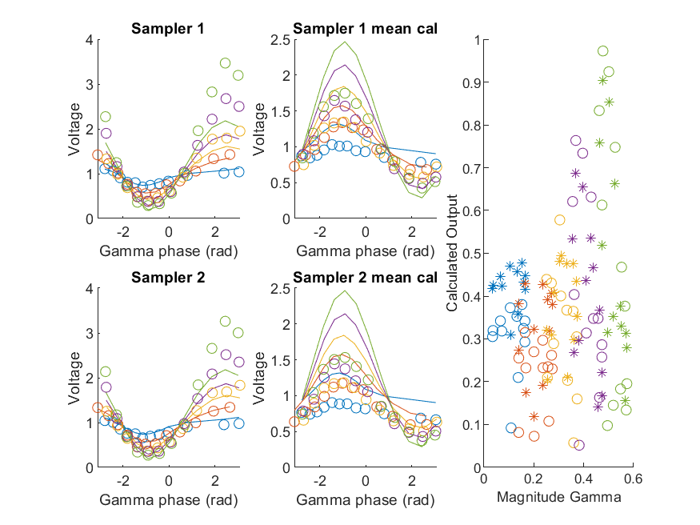
Coupled Line Performance At 10.70 GHz, 18.000000 dBm Output Power 1.00 V mean sampler bias
Sampler Av
Sampler 1: 7.4e-06
Sampler 2: 1.3e-05
Sampler 1 linear: 7.9e-06
Sampler 2 linear: 1.4e-05
Sampler Offset
Sampler 1: 0.0084
Sampler 2: 0.009
RMSE
Linear: 0.66
Individual: 0.64

Slide 13
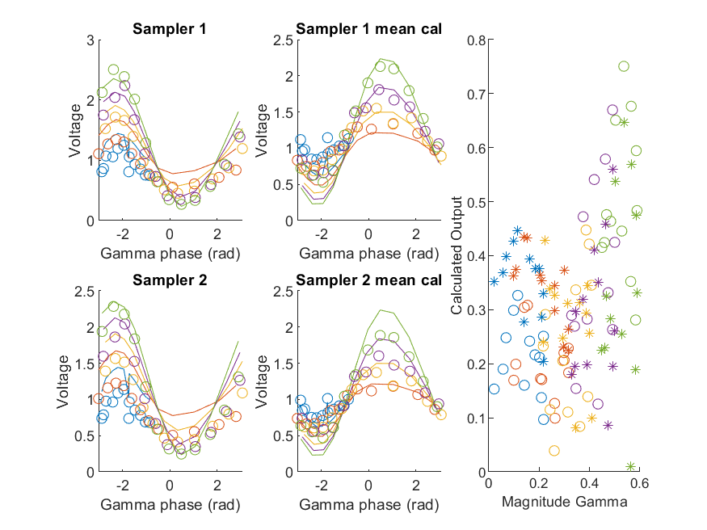
Coupled Line Performance At 10.80 GHz, 18.000000 dBm Output Power 1.00 V mean sampler bias
Sampler Av
Sampler 1: 7.9e-06
Sampler 2: 1.1e-05
Sampler 1 linear: 8.6e-06
Sampler 2 linear: 1.3e-05
Sampler Offset
Sampler 1: 0.0084
Sampler 2: 0.009
RMSE
Linear: 0.56
Individual: 0.54

Slide 14
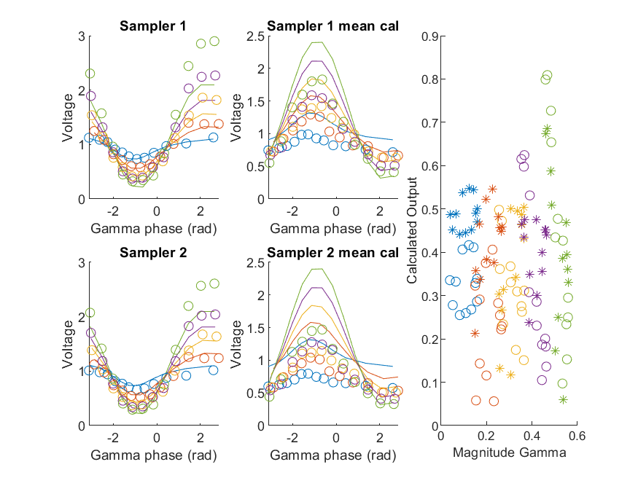
Coupled Line Performance At 10.90 GHz, 18.000000 dBm Output Power 1.00 V mean sampler bias
Sampler Av
Sampler 1: 7.9e-06
Sampler 2: 1.2e-05
Sampler 1 linear: 8.8e-06
Sampler 2 linear: 1.5e-05
Sampler Offset
Sampler 1: 0.0084
Sampler 2: 0.0089
RMSE
Linear: 0.65
Individual: 0.58

Slide 15
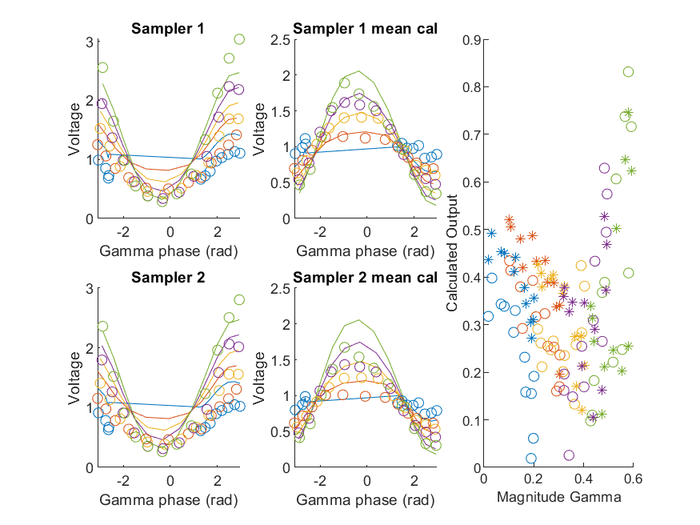
Coupled Line Performance At 11.00 GHz, 18.000000 dBm Output Power 1.00 V mean sampler bias
Sampler Av
Sampler 1: 8.7e-06
Sampler 2: 1.1e-05
Sampler 1 linear: 9.4e-06
Sampler 2 linear: 1.2e-05
Sampler Offset
Sampler 1: 0.0084
Sampler 2: 0.009
RMSE
Linear: 0.58
Individual: 0.57

Slide 16
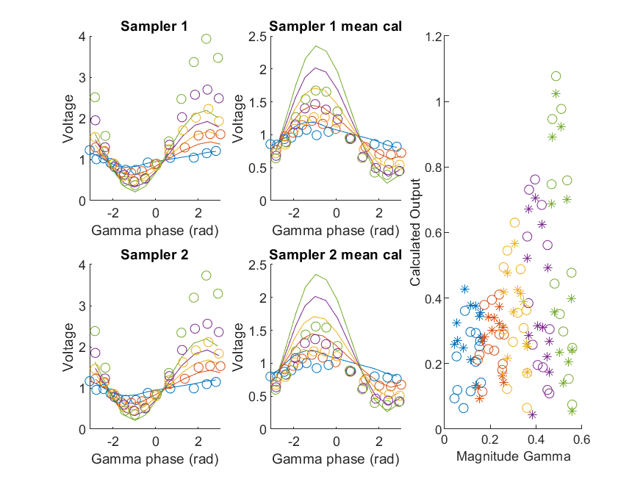
Coupled Line Performance At 11.10 GHz, 18.000000 dBm Output Power 1.00 V mean sampler bias
Sampler Av
Sampler 1: 6.7e-06
Sampler 2: 1.4e-05
Sampler 1 linear: 7.1e-06
Sampler 2 linear: 1.5e-05
Sampler Offset
Sampler 1: 0.0084
Sampler 2: 0.009
RMSE
Linear: 0.64
Individual: 0.63

Slide 17
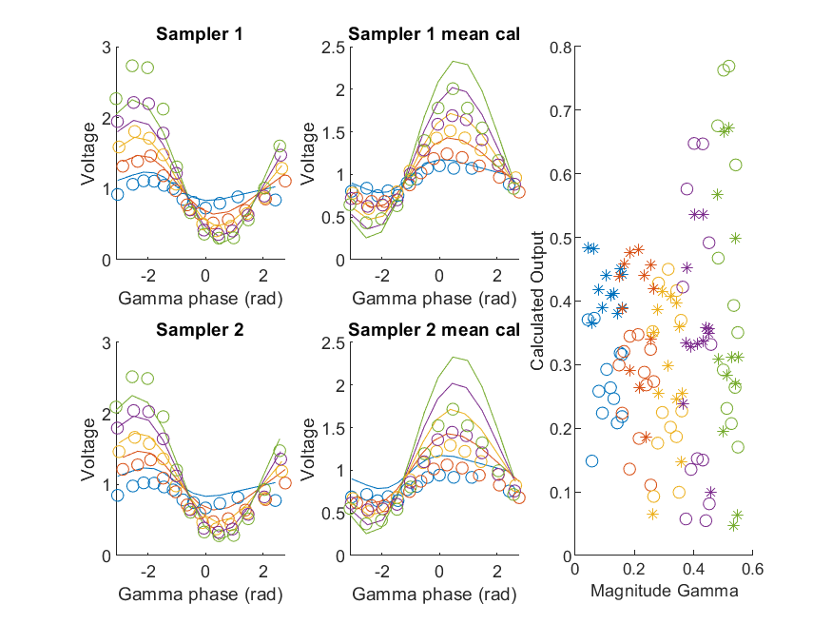
Coupled Line Performance At 11.20 GHz, 18.000000 dBm Output Power 1.00 V mean sampler bias
Sampler Av
Sampler 1: 8.8e-06
Sampler 2: 1.2e-05
Sampler 1 linear: 9.5e-06
Sampler 2 linear: 1.4e-05
Sampler Offset
Sampler 1: 0.0084
Sampler 2: 0.009
RMSE
Linear: 0.55
Individual: 0.54

Slide 18
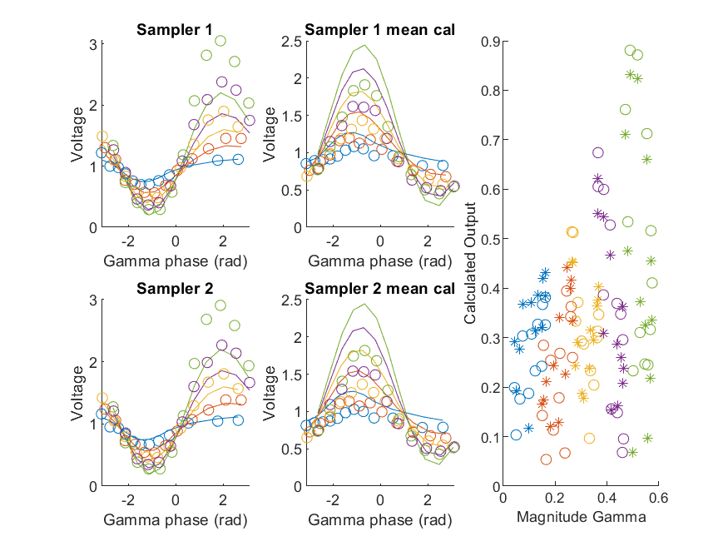
Coupled Line Performance At 11.30 GHz, 18.000000 dBm Output Power 1.00 V mean sampler bias
Sampler Av
Sampler 1: 9.1e-06
Sampler 2: 1.2e-05
Sampler 1 linear: 9.6e-06
Sampler 2 linear: 1.2e-05
Sampler Offset
Sampler 1: 0.0084
Sampler 2: 0.009
RMSE
Linear: 0.57
Individual: 0.56

Slide 19
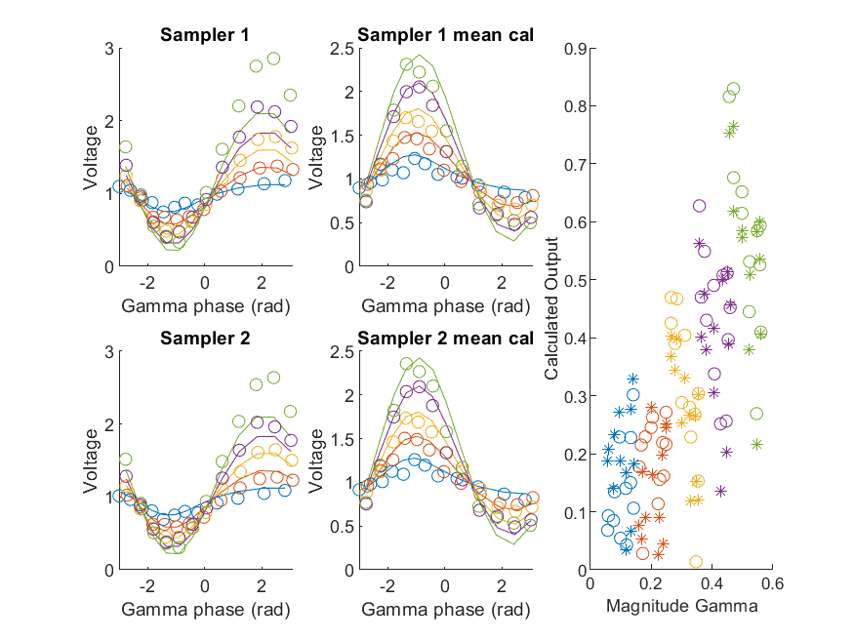
Coupled Line Performance At 11.40 GHz, 18.000000 dBm Output Power 1.00 V mean sampler bias
Sampler Av
Sampler 1: 8.9e-06
Sampler 2: 1.2e-05
Sampler 1 linear: 9.6e-06
Sampler 2 linear: 1.2e-05
Sampler Offset
Sampler 1: 0.0084
Sampler 2: 0.009
RMSE
Linear: 0.49
Individual: 0.51

Slide 20
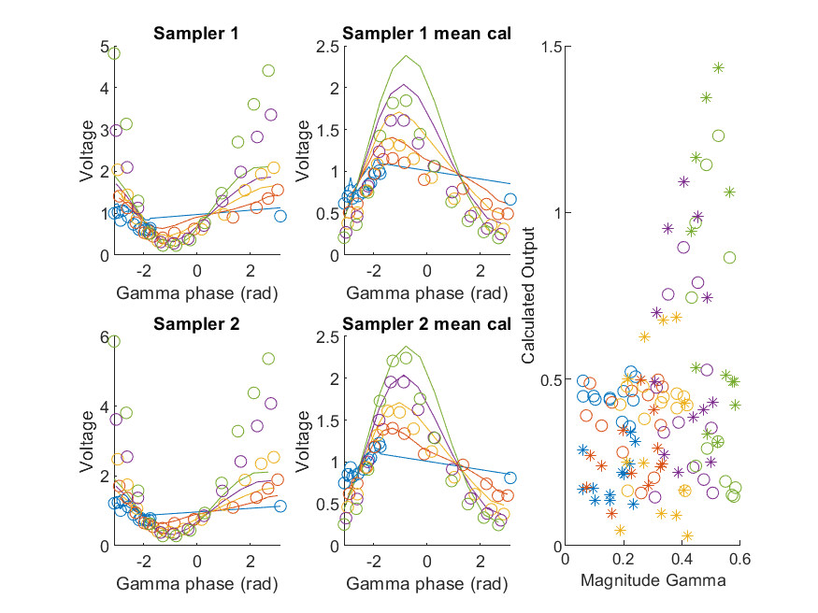
Coupled Line Performance At 10.60 GHz, 20.000000 dBm Output Power 1.00 V mean sampler bias
Sampler Av
Sampler 1: 9.6e-06
Sampler 2: 1.4e-05
Sampler 1 linear: 7.9e-06
Sampler 2 linear: 1.1e-05
Sampler Offset
Sampler 1: 0.0084
Sampler 2: 0.009
RMSE
Linear: 0.75
Individual: 0.74

Slide 21
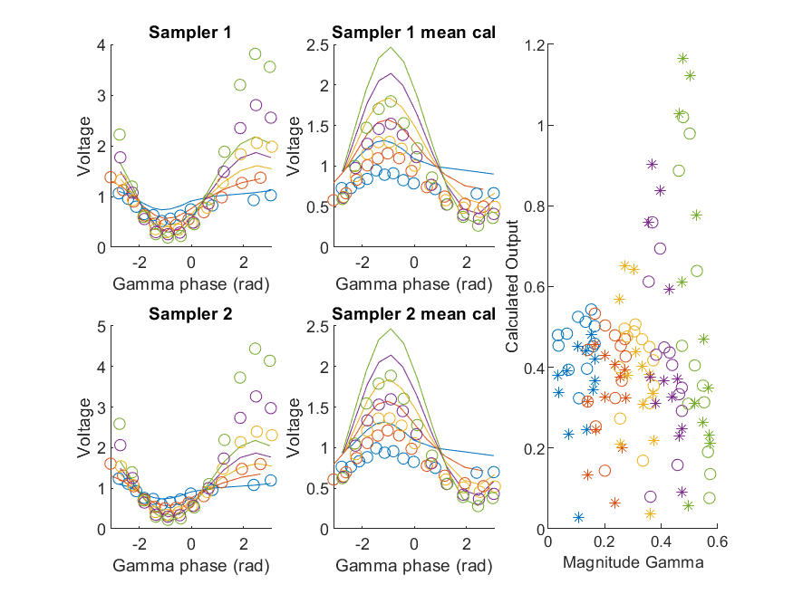
Coupled Line Performance At 10.70 GHz, 20.000000 dBm Output Power 1.00 V mean sampler bias
Sampler Av
Sampler 1: 9.1e-06
Sampler 2: 1.5e-05
Sampler 1 linear: 7.9e-06
Sampler 2 linear: 1.4e-05
Sampler Offset
Sampler 1: 0.0084
Sampler 2: 0.009
RMSE
Linear: 0.7
Individual: 0.69

Slide 22
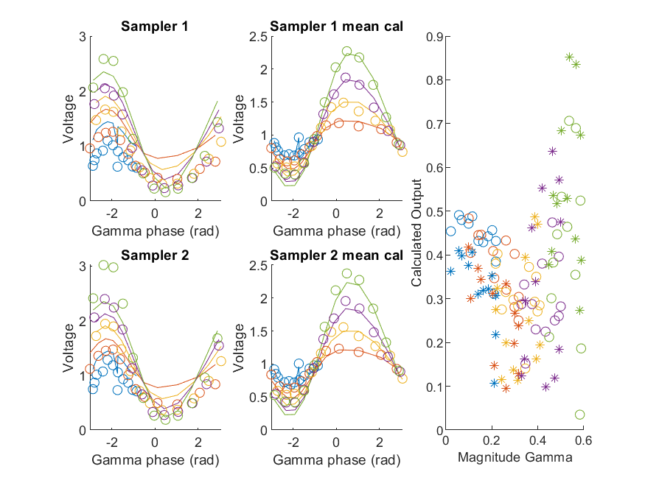
Coupled Line Performance At 10.80 GHz, 20.000000 dBm Output Power 1.00 V mean sampler bias
Sampler Av
Sampler 1: 1e-05
Sampler 2: 1.4e-05
Sampler 1 linear: 8.6e-06
Sampler 2 linear: 1.3e-05
Sampler Offset
Sampler 1: 0.0084
Sampler 2: 0.009
RMSE
Linear: 0.57
Individual: 0.59

Slide 23
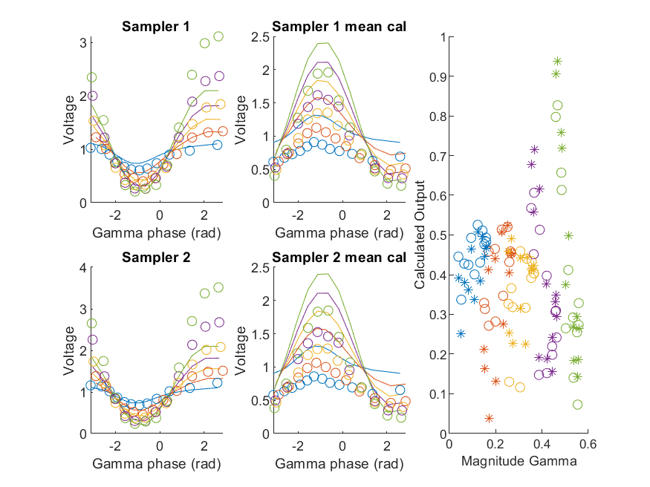
Coupled Line Performance At 10.90 GHz, 20.000000 dBm Output Power 1.00 V mean sampler bias
Sampler Av
Sampler 1: 9.9e-06
Sampler 2: 1.4e-05
Sampler 1 linear: 8.8e-06
Sampler 2 linear: 1.5e-05
Sampler Offset
Sampler 1: 0.0084
Sampler 2: 0.0089
RMSE
Linear: 0.65
Individual: 0.62

Slide 24
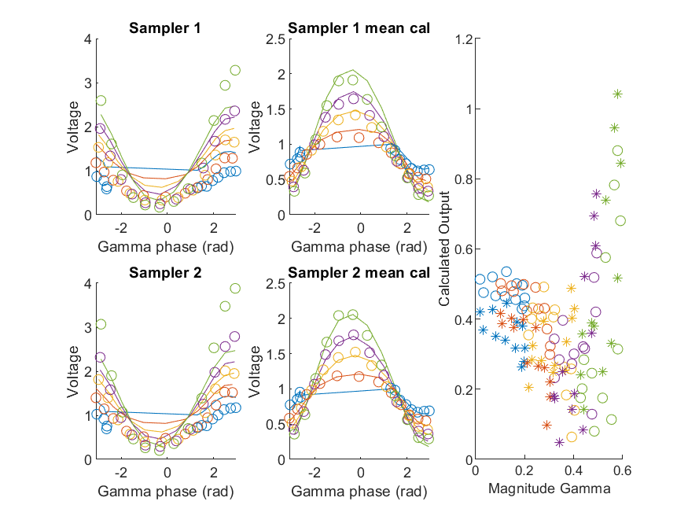
Coupled Line Performance At 11.00 GHz, 20.000000 dBm Output Power 1.00 V mean sampler bias
Sampler Av
Sampler 1: 1.1e-05
Sampler 2: 1.3e-05
Sampler 1 linear: 9.4e-06
Sampler 2 linear: 1.2e-05
Sampler Offset
Sampler 1: 0.0084
Sampler 2: 0.009
RMSE
Linear: 0.63
Individual: 0.6

Slide 25
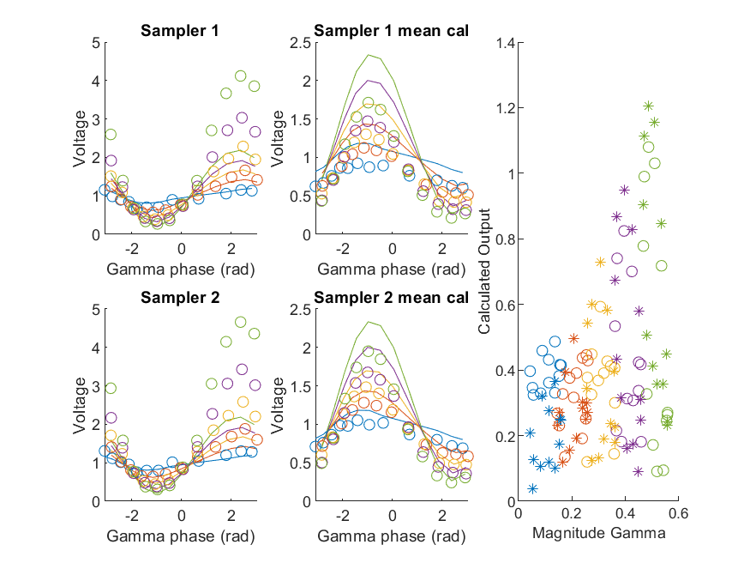
Coupled Line Performance At 11.10 GHz, 20.000000 dBm Output Power 1.00 V mean sampler bias
Sampler Av
Sampler 1: 8e-06
Sampler 2: 1.7e-05
Sampler 1 linear: 7.1e-06
Sampler 2 linear: 1.5e-05
Sampler Offset
Sampler 1: 0.0084
Sampler 2: 0.009
RMSE
Linear: 0.67
Individual: 0.68

Slide 26
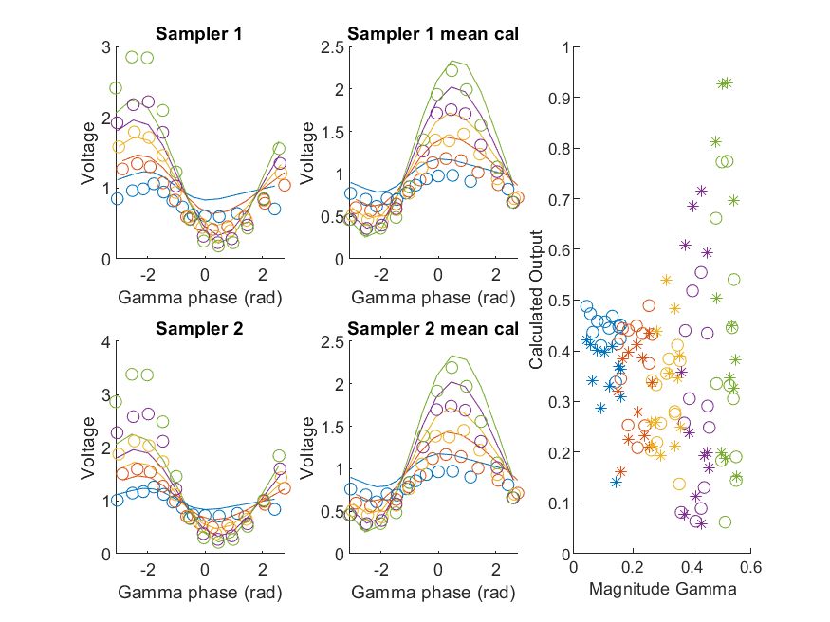
Coupled Line Performance At 11.20 GHz, 20.000000 dBm Output Power 1.00 V mean sampler bias
Sampler Av
Sampler 1: 1.1e-05
Sampler 2: 1.3e-05
Sampler 1 linear: 9.5e-06
Sampler 2 linear: 1.4e-05
Sampler Offset
Sampler 1: 0.0084
Sampler 2: 0.009
RMSE
Linear: 0.58
Individual: 0.56

Slide 27
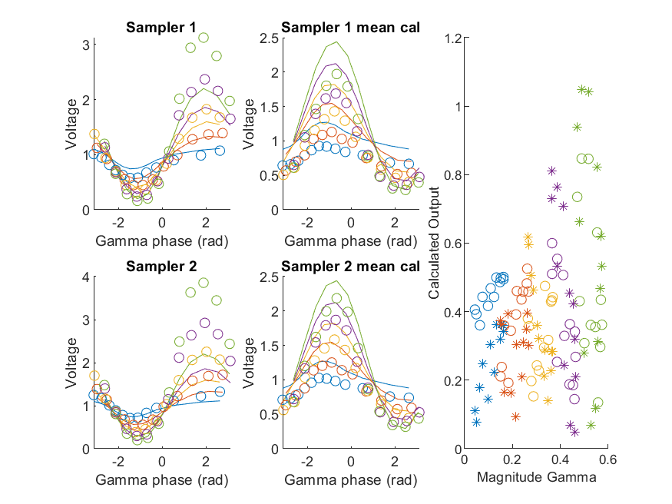
Coupled Line Performance At 11.30 GHz, 20.000000 dBm Output Power 1.00 V mean sampler bias
Sampler Av
Sampler 1: 1.2e-05
Sampler 2: 1.4e-05
Sampler 1 linear: 9.6e-06
Sampler 2 linear: 1.2e-05
Sampler Offset
Sampler 1: 0.0084
Sampler 2: 0.009
RMSE
Linear: 0.59
Individual: 0.61

Slide 28
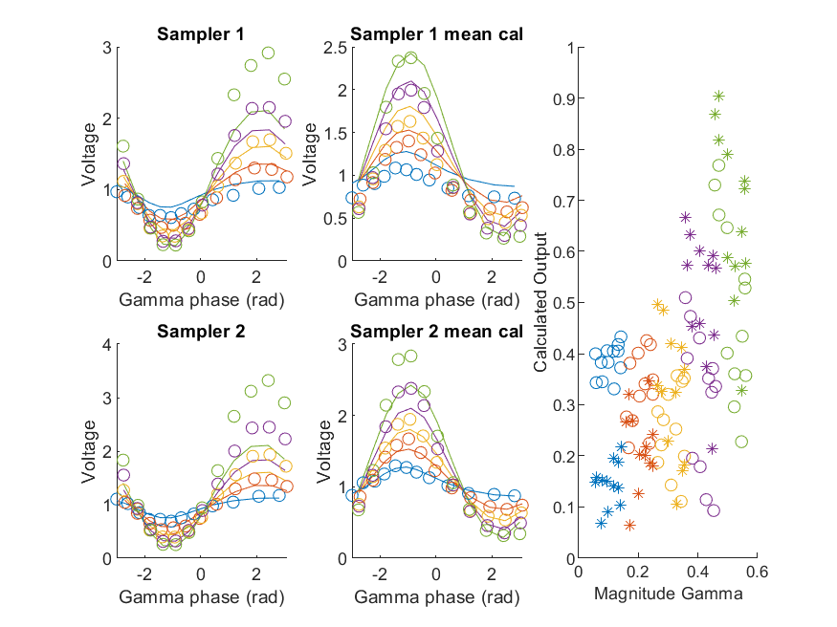
Coupled Line Performance At 11.40 GHz, 20.000000 dBm Output Power 1.00 V mean sampler bias
Sampler Av
Sampler 1: 1.1e-05
Sampler 2: 1.4e-05
Sampler 1 linear: 9.6e-06
Sampler 2 linear: 1.2e-05
Sampler Offset
Sampler 1: 0.0084
Sampler 2: 0.009
RMSE
Linear: 0.55
Individual: 0.54

Slide 29
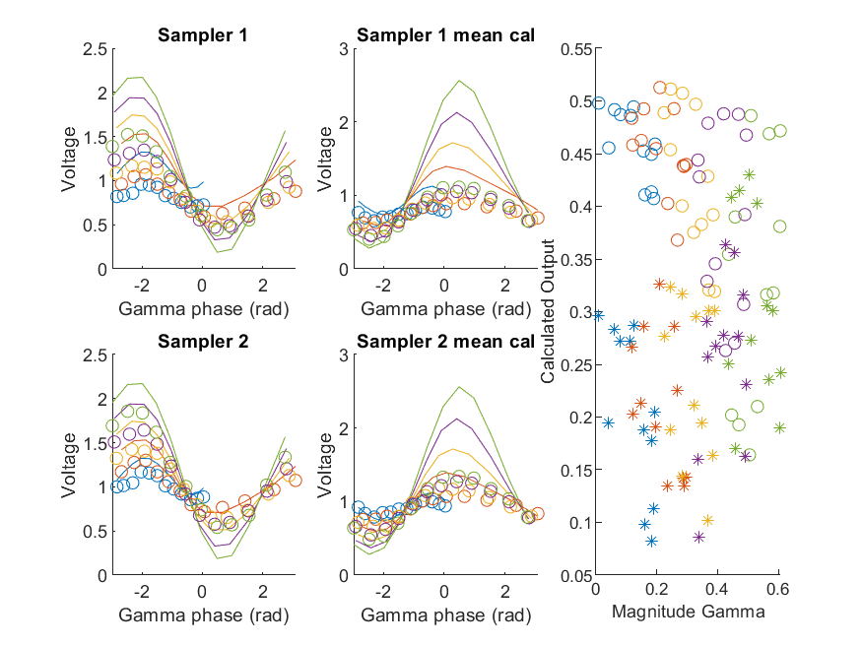
Coupled Line Performance At 10.50 GHz, 12.000000 dBm Output Power 1.25 V mean sampler bias
Sampler Av
Sampler 1: 0.00027
Sampler 2: 0.00035
Sampler 1 linear: 0.00022
Sampler 2 linear: 0.00029
Sampler Offset
Sampler 1: 0.027
Sampler 2: 0.026
RMSE
Linear: 0.43
Individual: 0.57

Slide 30
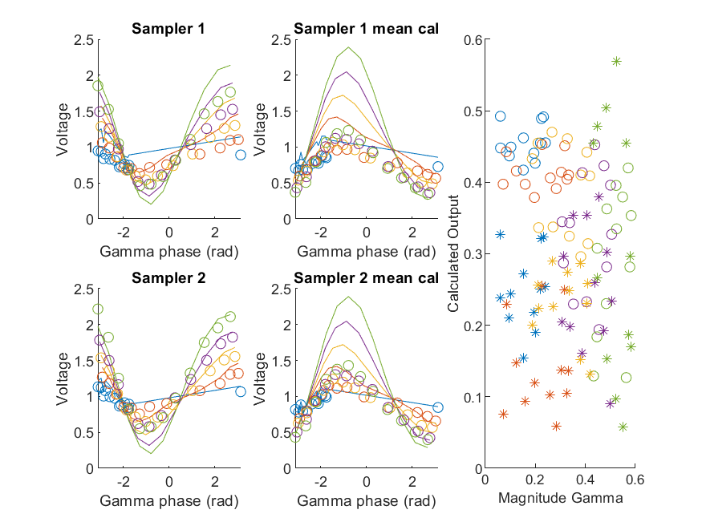
Coupled Line Performance At 10.60 GHz, 12.000000 dBm Output Power 1.25 V mean sampler bias
Sampler Av
Sampler 1: 0.00027
Sampler 2: 0.00029
Sampler 1 linear: 0.00022
Sampler 2 linear: 0.00025
Sampler Offset
Sampler 1: 0.027
Sampler 2: 0.026
RMSE
Linear: 0.54
Individual: 0.61

Slide 31
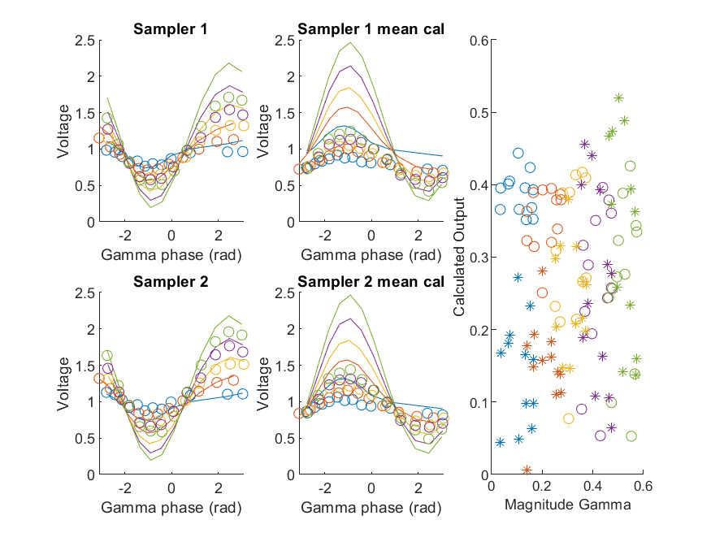
Coupled Line Performance At 10.70 GHz, 12.000000 dBm Output Power 1.25 V mean sampler bias
Sampler Av
Sampler 1: 0.00027
Sampler 2: 0.00032
Sampler 1 linear: 0.00023
Sampler 2 linear: 0.00028
Sampler Offset
Sampler 1: 0.027
Sampler 2: 0.026
RMSE
Linear: 0.51
Individual: 0.55

Slide 32
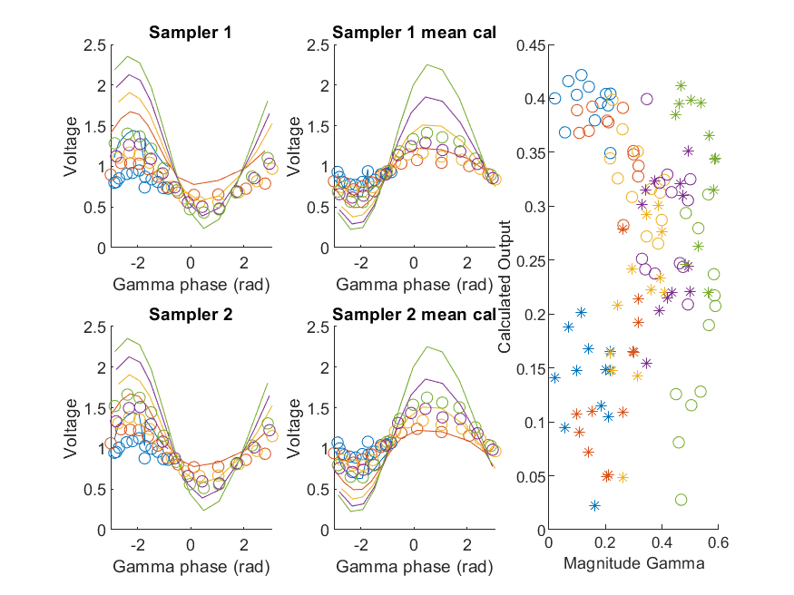
Coupled Line Performance At 10.80 GHz, 12.000000 dBm Output Power 1.25 V mean sampler bias
Sampler Av
Sampler 1: 0.00029
Sampler 2: 0.00029
Sampler 1 linear: 0.00025
Sampler 2 linear: 0.00025
Sampler Offset
Sampler 1: 0.027
Sampler 2: 0.026
RMSE
Linear: 0.46
Individual: 0.54

Slide 33
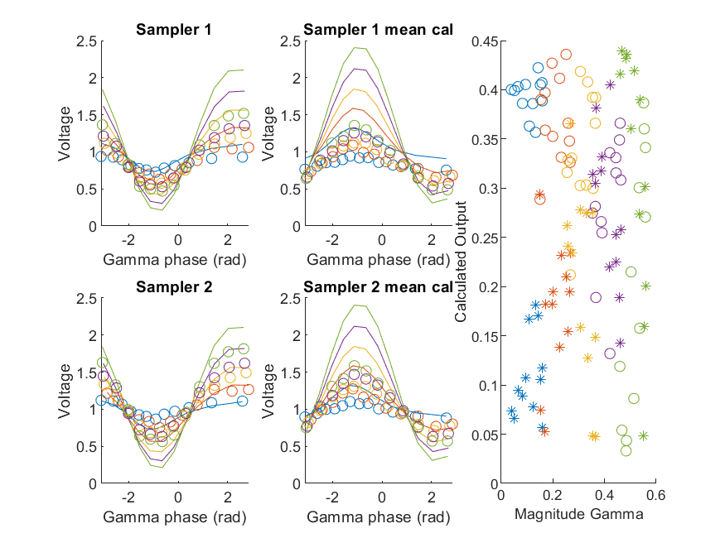
Coupled Line Performance At 10.90 GHz, 12.000000 dBm Output Power 1.25 V mean sampler bias
Sampler Av
Sampler 1: 0.00029
Sampler 2: 0.0003
Sampler 1 linear: 0.00024
Sampler 2 linear: 0.00025
Sampler Offset
Sampler 1: 0.027
Sampler 2: 0.026
RMSE
Linear: 0.46
Individual: 0.53

Slide 34
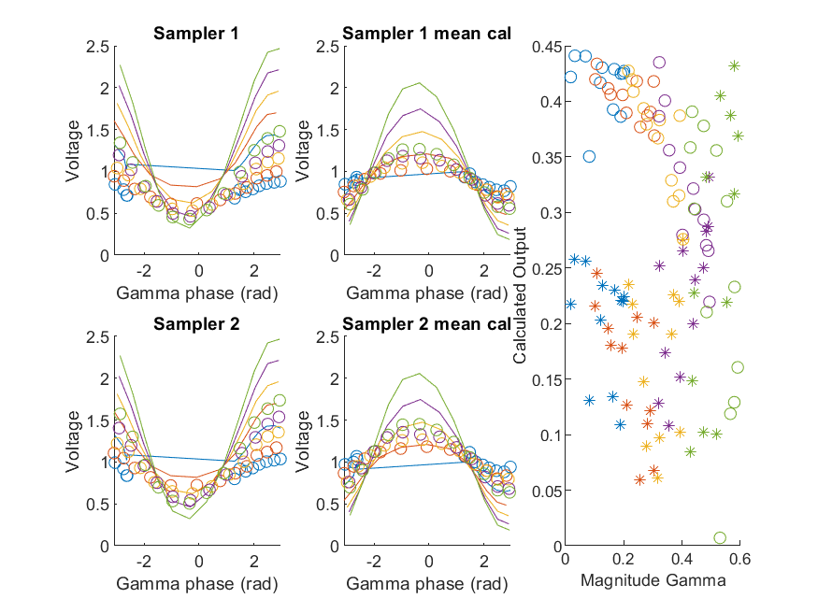
Coupled Line Performance At 11.00 GHz, 12.000000 dBm Output Power 1.25 V mean sampler bias
Sampler Av
Sampler 1: 0.00032
Sampler 2: 0.00031
Sampler 1 linear: 0.00028
Sampler 2 linear: 0.00027
Sampler Offset
Sampler 1: 0.027
Sampler 2: 0.026
RMSE
Linear: 0.47
Individual: 0.5

Slide 35
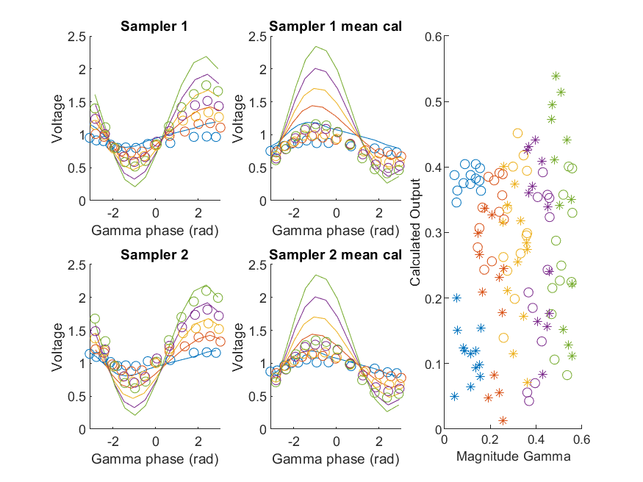
Coupled Line Performance At 11.10 GHz, 12.000000 dBm Output Power 1.25 V mean sampler bias
Sampler Av
Sampler 1: 0.00026
Sampler 2: 0.00034
Sampler 1 linear: 0.00022
Sampler 2 linear: 0.0003
Sampler Offset
Sampler 1: 0.027
Sampler 2: 0.026
RMSE
Linear: 0.5
Individual: 0.55

Slide 36
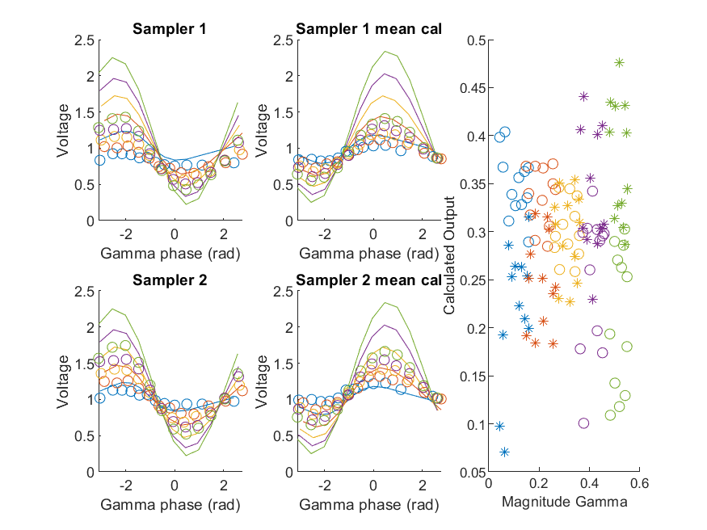
Coupled Line Performance At 11.20 GHz, 12.000000 dBm Output Power 1.25 V mean sampler bias
Sampler Av
Sampler 1: 0.00031
Sampler 2: 0.00029
Sampler 1 linear: 0.00026
Sampler 2 linear: 0.00025
Sampler Offset
Sampler 1: 0.027
Sampler 2: 0.026
RMSE
Linear: 0.46
Individual: 0.47

Slide 37
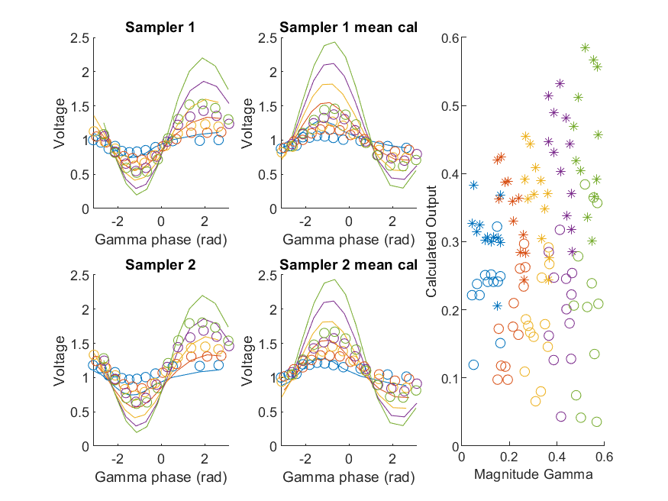
Coupled Line Performance At 11.30 GHz, 12.000000 dBm Output Power 1.25 V mean sampler bias
Sampler Av
Sampler 1: 0.00031
Sampler 2: 0.00029
Sampler 1 linear: 0.00027
Sampler 2 linear: 0.00025
Sampler Offset
Sampler 1: 0.027
Sampler 2: 0.026
RMSE
Linear: 0.51
Individual: 0.44

Slide 38
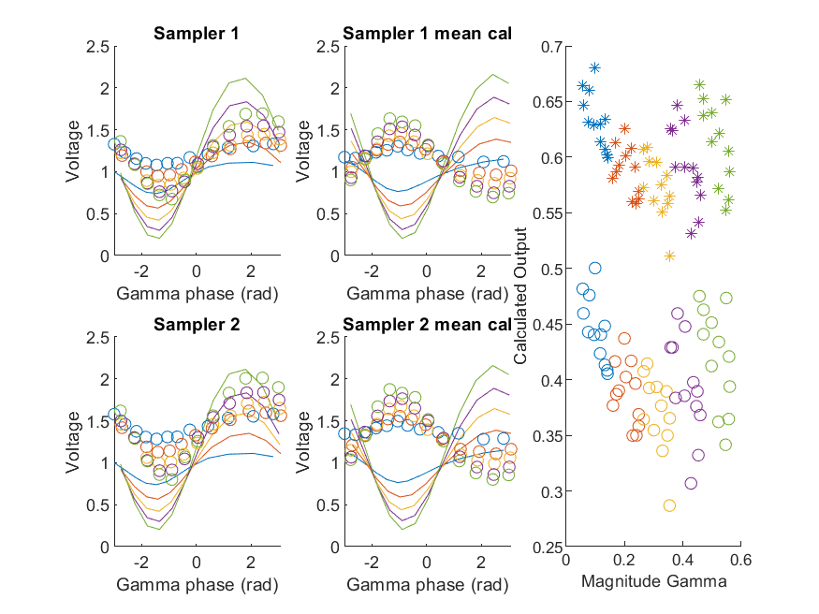
Coupled Line Performance At 11.40 GHz, 12.000000 dBm Output Power 1.25 V mean sampler bias
Sampler Av
Sampler 1: 0.0003
Sampler 2: 0.00031
Sampler 1 linear: 0.00025
Sampler 2 linear: 0.00027
Sampler Offset
Sampler 1: 0.027
Sampler 2: 0.026
RMSE
Linear: 0.69
Individual: 0.52

Slide 39
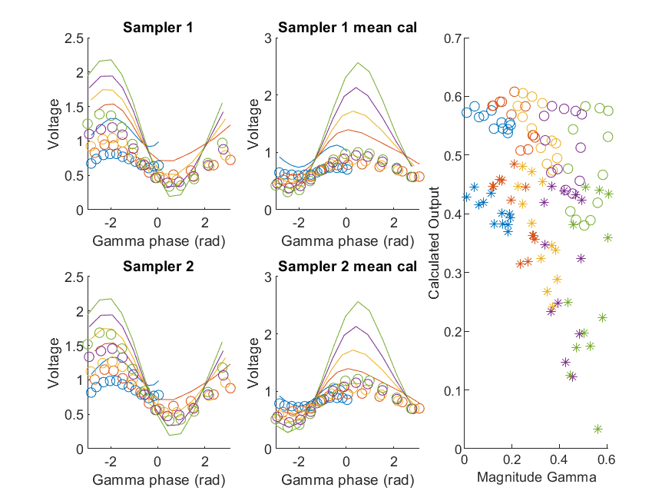
Coupled Line Performance At 10.50 GHz, 14.000000 dBm Output Power 1.25 V mean sampler bias
Sampler Av
Sampler 1: 0.00027
Sampler 2: 0.00035
Sampler 1 linear: 0.00022
Sampler 2 linear: 0.00029
Sampler Offset
Sampler 1: 0.027
Sampler 2: 0.026
RMSE
Linear: 0.52
Individual: 0.68

Slide 40
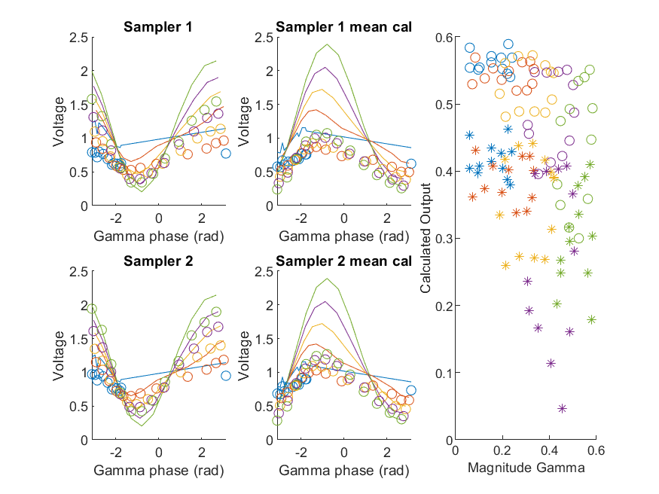
Coupled Line Performance At 10.60 GHz, 14.000000 dBm Output Power 1.25 V mean sampler bias
Sampler Av
Sampler 1: 0.00027
Sampler 2: 0.0003
Sampler 1 linear: 0.00022
Sampler 2 linear: 0.00025
Sampler Offset
Sampler 1: 0.027
Sampler 2: 0.026
RMSE
Linear: 0.6
Individual: 0.7

Slide 41
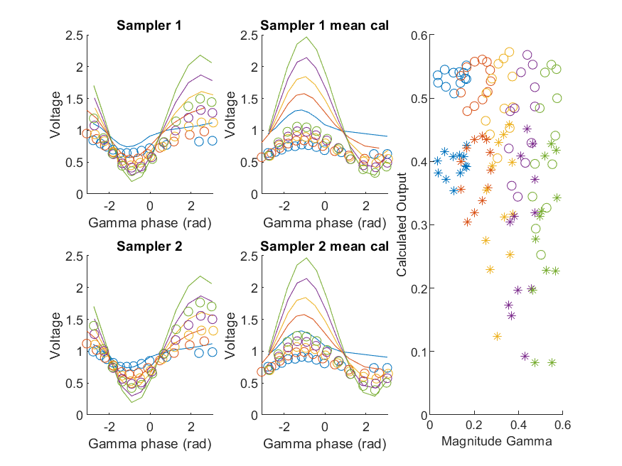
Coupled Line Performance At 10.70 GHz, 14.000000 dBm Output Power 1.25 V mean sampler bias
Sampler Av
Sampler 1: 0.00027
Sampler 2: 0.00033
Sampler 1 linear: 0.00023
Sampler 2 linear: 0.00028
Sampler Offset
Sampler 1: 0.027
Sampler 2: 0.026
RMSE
Linear: 0.57
Individual: 0.67

Slide 42
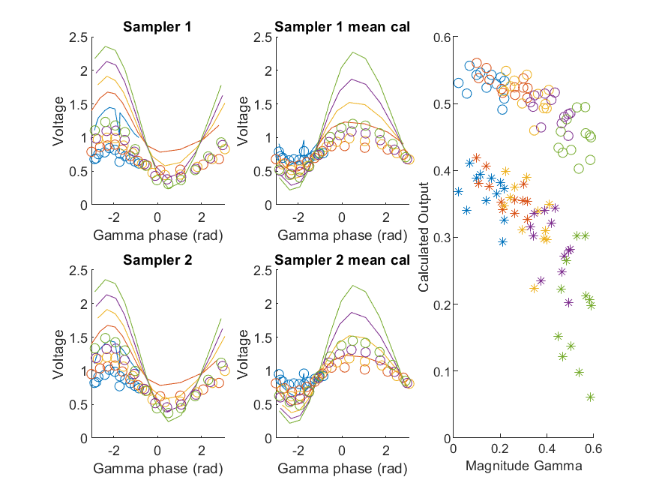
Coupled Line Performance At 10.80 GHz, 14.000000 dBm Output Power 1.25 V mean sampler bias
Sampler Av
Sampler 1: 0.0003
Sampler 2: 0.00031
Sampler 1 linear: 0.00025
Sampler 2 linear: 0.00025
Sampler Offset
Sampler 1: 0.027
Sampler 2: 0.026
RMSE
Linear: 0.53
Individual: 0.69

Slide 43
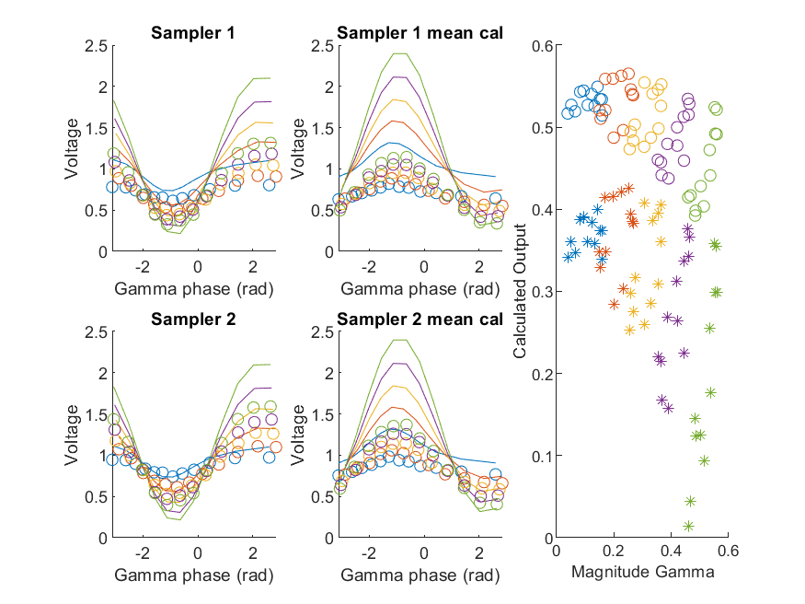
Coupled Line Performance At 10.90 GHz, 14.000000 dBm Output Power 1.25 V mean sampler bias
Sampler Av
Sampler 1: 0.00029
Sampler 2: 0.00031
Sampler 1 linear: 0.00024
Sampler 2 linear: 0.00025
Sampler Offset
Sampler 1: 0.027
Sampler 2: 0.026
RMSE
Linear: 0.53
Individual: 0.66

Slide 44
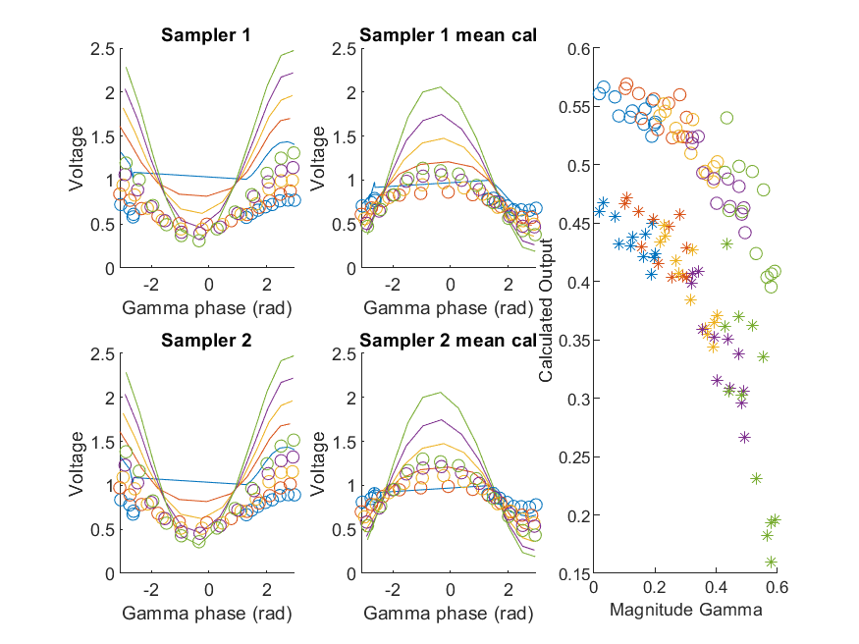
Coupled Line Performance At 11.00 GHz, 14.000000 dBm Output Power 1.25 V mean sampler bias
Sampler Av
Sampler 1: 0.00032
Sampler 2: 0.00031
Sampler 1 linear: 0.00028
Sampler 2 linear: 0.00027
Sampler Offset
Sampler 1: 0.027
Sampler 2: 0.026
RMSE
Linear: 0.51
Individual: 0.6

Slide 45
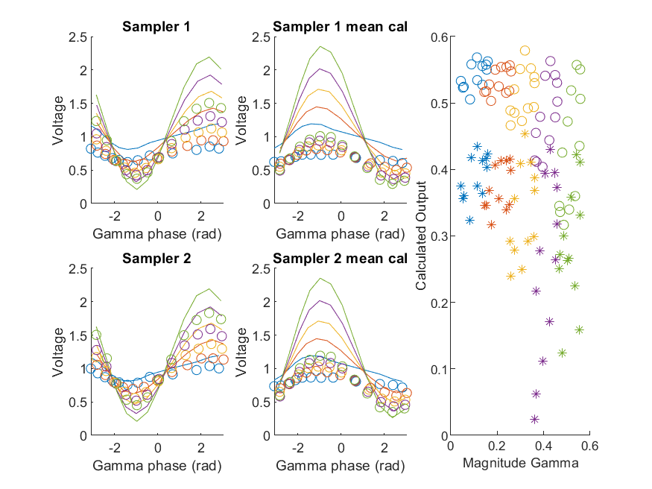
Coupled Line Performance At 11.10 GHz, 14.000000 dBm Output Power 1.25 V mean sampler bias
Sampler Av
Sampler 1: 0.00027
Sampler 2: 0.00035
Sampler 1 linear: 0.00022
Sampler 2 linear: 0.0003
Sampler Offset
Sampler 1: 0.027
Sampler 2: 0.026
RMSE
Linear: 0.56
Individual: 0.66

Slide 46
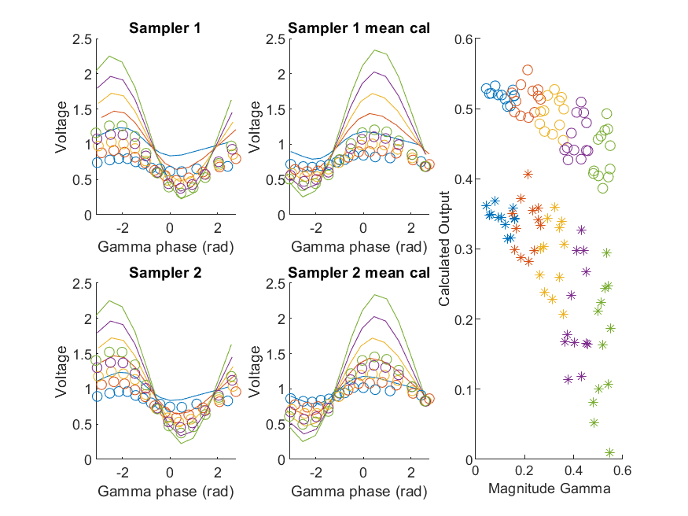
Coupled Line Performance At 11.20 GHz, 14.000000 dBm Output Power 1.25 V mean sampler bias
Sampler Av
Sampler 1: 0.00031
Sampler 2: 0.0003
Sampler 1 linear: 0.00026
Sampler 2 linear: 0.00025
Sampler Offset
Sampler 1: 0.027
Sampler 2: 0.026
RMSE
Linear: 0.46
Individual: 0.62

Slide 47
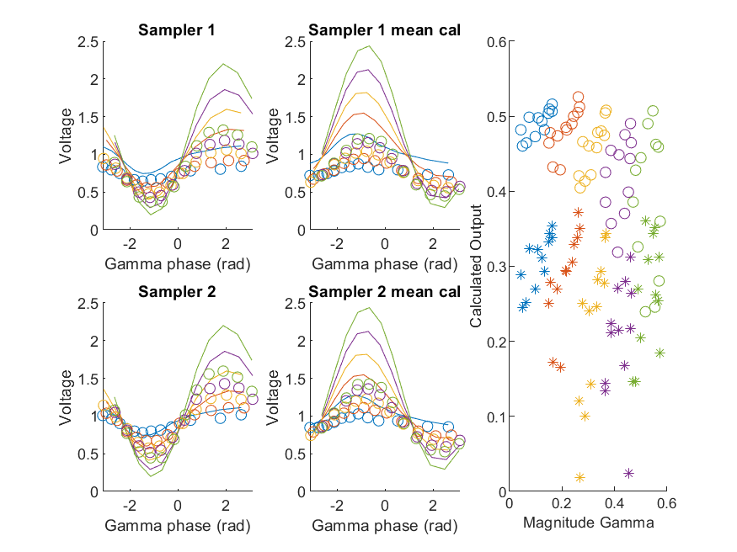
Coupled Line Performance At 11.30 GHz, 14.000000 dBm Output Power 1.25 V mean sampler bias
Sampler Av
Sampler 1: 0.00032
Sampler 2: 0.0003
Sampler 1 linear: 0.00027
Sampler 2 linear: 0.00025
Sampler Offset
Sampler 1: 0.027
Sampler 2: 0.026
RMSE
Linear: 0.49
Individual: 0.63

Slide 48
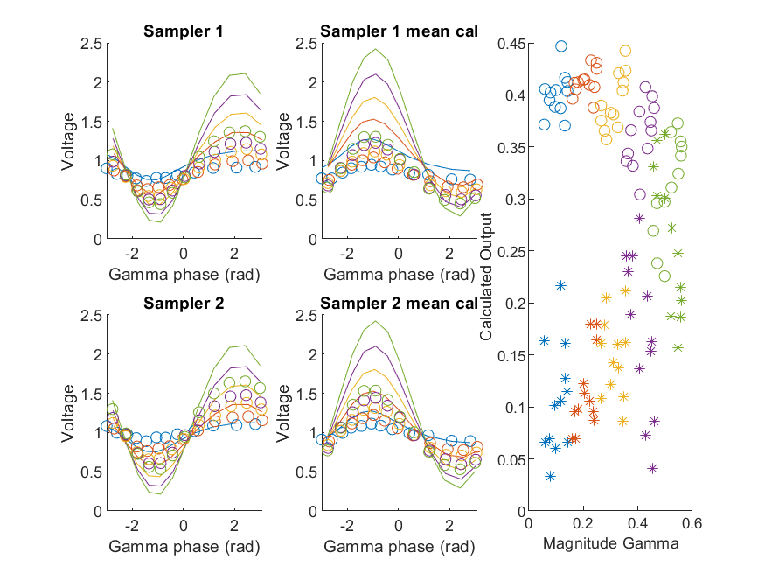
Coupled Line Performance At 11.40 GHz, 14.000000 dBm Output Power 1.25 V mean sampler bias
Sampler Av
Sampler 1: 0.0003
Sampler 2: 0.00031
Sampler 1 linear: 0.00025
Sampler 2 linear: 0.00027
Sampler Offset
Sampler 1: 0.027
Sampler 2: 0.026
RMSE
Linear: 0.39
Individual: 0.56

Slide 49
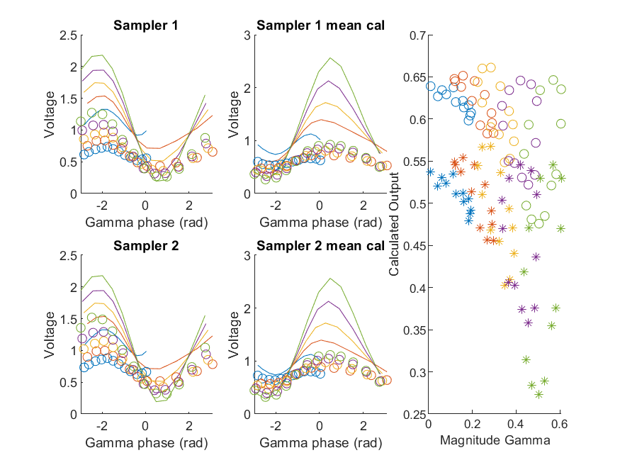
Coupled Line Performance At 10.50 GHz, 16.000000 dBm Output Power 1.25 V mean sampler bias
Sampler Av
Sampler 1: 0.00026
Sampler 2: 0.00035
Sampler 1 linear: 0.00022
Sampler 2 linear: 0.00029
Sampler Offset
Sampler 1: 0.027
Sampler 2: 0.026
RMSE
Linear: 0.63
Individual: 0.74

Slide 50
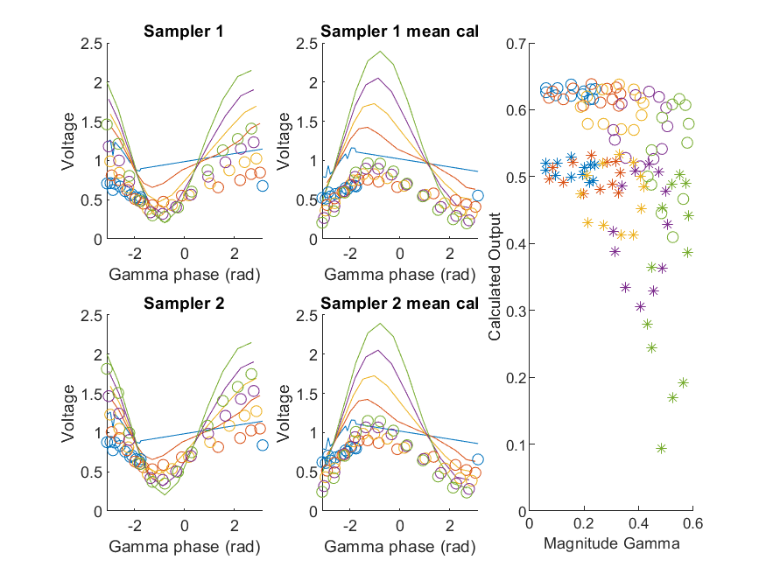
Coupled Line Performance At 10.60 GHz, 16.000000 dBm Output Power 1.25 V mean sampler bias
Sampler Av
Sampler 1: 0.00028
Sampler 2: 0.0003
Sampler 1 linear: 0.00022
Sampler 2 linear: 0.00025
Sampler Offset
Sampler 1: 0.027
Sampler 2: 0.026
RMSE
Linear: 0.66
Individual: 0.77

Slide 51
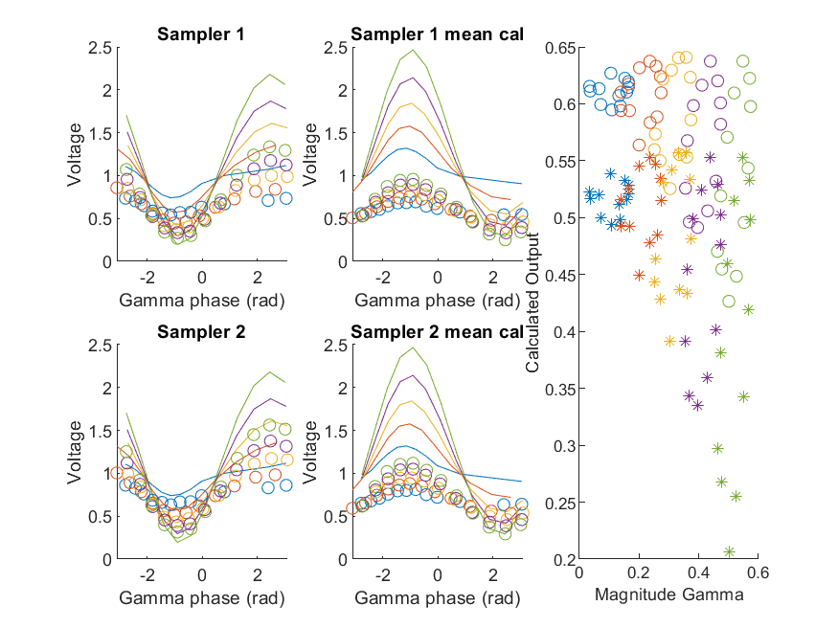
Coupled Line Performance At 10.70 GHz, 16.000000 dBm Output Power 1.25 V mean sampler bias
Sampler Av
Sampler 1: 0.00027
Sampler 2: 0.00033
Sampler 1 linear: 0.00023
Sampler 2 linear: 0.00028
Sampler Offset
Sampler 1: 0.027
Sampler 2: 0.026
RMSE
Linear: 0.65
Individual: 0.74

Slide 52

Coupled Line Performance At 10.80 GHz, 16.000000 dBm Output Power 1.25 V mean sampler bias
Sampler Av
Sampler 1: 0.00029
Sampler 2: 0.00031
Sampler 1 linear: 0.00025
Sampler 2 linear: 0.00025
Sampler Offset
Sampler 1: 0.027
Sampler 2: 0.026
RMSE
Linear: 0.65
Individual: 0.76

Slide 53

Coupled Line Performance At 10.90 GHz, 16.000000 dBm Output Power 1.25 V mean sampler bias
Sampler Av
Sampler 1: 0.00029
Sampler 2: 0.00031
Sampler 1 linear: 0.00024
Sampler 2 linear: 0.00025
Sampler Offset
Sampler 1: 0.027
Sampler 2: 0.026
RMSE
Linear: 0.63
Individual: 0.73

Slide 54

Coupled Line Performance At 11.00 GHz, 16.000000 dBm Output Power 1.25 V mean sampler bias
Sampler Av
Sampler 1: 0.00031
Sampler 2: 0.00031
Sampler 1 linear: 0.00028
Sampler 2 linear: 0.00027
Sampler Offset
Sampler 1: 0.027
Sampler 2: 0.026
RMSE
Linear: 0.6
Individual: 0.67

Slide 55

Coupled Line Performance At 11.10 GHz, 16.000000 dBm Output Power 1.25 V mean sampler bias
Sampler Av
Sampler 1: 0.00026
Sampler 2: 0.00035
Sampler 1 linear: 0.00022
Sampler 2 linear: 0.0003
Sampler Offset
Sampler 1: 0.027
Sampler 2: 0.026
RMSE
Linear: 0.63
Individual: 0.73

Slide 56

Coupled Line Performance At 11.20 GHz, 16.000000 dBm Output Power 1.25 V mean sampler bias
Sampler Av
Sampler 1: 0.00031
Sampler 2: 0.0003
Sampler 1 linear: 0.00026
Sampler 2 linear: 0.00025
Sampler Offset
Sampler 1: 0.027
Sampler 2: 0.026
RMSE
Linear: 0.59
Individual: 0.7

Slide 57

Coupled Line Performance At 11.30 GHz, 16.000000 dBm Output Power 1.25 V mean sampler bias
Sampler Av
Sampler 1: 0.00032
Sampler 2: 0.0003
Sampler 1 linear: 0.00027
Sampler 2 linear: 0.00025
Sampler Offset
Sampler 1: 0.027
Sampler 2: 0.026
RMSE
Linear: 0.61
Individual: 0.71

Slide 58

Coupled Line Performance At 11.40 GHz, 16.000000 dBm Output Power 1.25 V mean sampler bias
Sampler Av
Sampler 1: 0.0003
Sampler 2: 0.00032
Sampler 1 linear: 0.00025
Sampler 2 linear: 0.00027
Sampler Offset
Sampler 1: 0.027
Sampler 2: 0.026
RMSE
Linear: 0.58
Individual: 0.69

Slide 59

Coupled Line Performance At 10.50 GHz, 8.000000 dBm Output Power 1.50 V mean sampler bias
Sampler Av
Sampler 1: 0.00041
Sampler 2: 0.0006
Sampler 1 linear: 0.00038
Sampler 2 linear: 0.00054
Sampler Offset
Sampler 1: 0.13
Sampler 2: 0.12
RMSE
Linear: 0.54
Individual: 0.46

Slide 60

Coupled Line Performance At 10.60 GHz, 8.000000 dBm Output Power 1.50 V mean sampler bias
Sampler Av
Sampler 1: 0.00046
Sampler 2: 0.00054
Sampler 1 linear: 0.00042
Sampler 2 linear: 0.00049
Sampler Offset
Sampler 1: 0.13
Sampler 2: 0.12
RMSE
Linear: 0.62
Individual: 0.51

Slide 61

Coupled Line Performance At 10.70 GHz, 8.000000 dBm Output Power 1.50 V mean sampler bias
Sampler Av
Sampler 1: 0.00041
Sampler 2: 0.00052
Sampler 1 linear: 0.00039
Sampler 2 linear: 0.0005
Sampler Offset
Sampler 1: 0.13
Sampler 2: 0.12
RMSE
Linear: 0.62
Individual: 0.57

Slide 62

Coupled Line Performance At 10.80 GHz, 8.000000 dBm Output Power 1.50 V mean sampler bias
Sampler Av
Sampler 1: 0.00043
Sampler 2: 0.00051
Sampler 1 linear: 0.00041
Sampler 2 linear: 0.00048
Sampler Offset
Sampler 1: 0.13
Sampler 2: 0.12
RMSE
Linear: 0.64
Individual: 0.59

Slide 63

Coupled Line Performance At 10.90 GHz, 8.000000 dBm Output Power 1.50 V mean sampler bias
Sampler Av
Sampler 1: 0.00044
Sampler 2: 0.0005
Sampler 1 linear: 0.00041
Sampler 2 linear: 0.00048
Sampler Offset
Sampler 1: 0.13
Sampler 2: 0.12
RMSE
Linear: 0.64
Individual: 0.59

Slide 64

Coupled Line Performance At 11.00 GHz, 8.000000 dBm Output Power 1.50 V mean sampler bias
Sampler Av
Sampler 1: 0.00048
Sampler 2: 0.00049
Sampler 1 linear: 0.00044
Sampler 2 linear: 0.00047
Sampler Offset
Sampler 1: 0.13
Sampler 2: 0.12
RMSE
Linear: 0.75
Individual: 0.67

Slide 65

Coupled Line Performance At 11.10 GHz, 8.000000 dBm Output Power 1.50 V mean sampler bias
Sampler Av
Sampler 1: 0.00039
Sampler 2: 0.00058
Sampler 1 linear: 0.00037
Sampler 2 linear: 0.00054
Sampler Offset
Sampler 1: 0.13
Sampler 2: 0.12
RMSE
Linear: 0.72
Individual: 0.66

Slide 66

Coupled Line Performance At 11.20 GHz, 8.000000 dBm Output Power 1.50 V mean sampler bias
Sampler Av
Sampler 1: 0.00046
Sampler 2: 0.00051
Sampler 1 linear: 0.00044
Sampler 2 linear: 0.00048
Sampler Offset
Sampler 1: 0.13
Sampler 2: 0.12
RMSE
Linear: 0.68
Individual: 0.63

Slide 67

Coupled Line Performance At 11.30 GHz, 8.000000 dBm Output Power 1.50 V mean sampler bias
Sampler Av
Sampler 1: 0.00046
Sampler 2: 0.0005
Sampler 1 linear: 0.00044
Sampler 2 linear: 0.00047
Sampler Offset
Sampler 1: 0.13
Sampler 2: 0.12
RMSE
Linear: 0.75
Individual: 0.71

Slide 68

Coupled Line Performance At 11.40 GHz, 8.000000 dBm Output Power 1.50 V mean sampler bias
Sampler Av
Sampler 1: 0.00044
Sampler 2: 0.00053
Sampler 1 linear: 0.00042
Sampler 2 linear: 0.0005
Sampler Offset
Sampler 1: 0.13
Sampler 2: 0.12
RMSE
Linear: 0.94
Individual: 0.89

Slide 69

Coupled Line Performance At 10.50 GHz, 10.000000 dBm Output Power 1.50 V mean sampler bias
Sampler Av
Sampler 1: 0.00046
Sampler 2: 0.00067
Sampler 1 linear: 0.00038
Sampler 2 linear: 0.00054
Sampler Offset
Sampler 1: 0.13
Sampler 2: 0.12
RMSE
Linear: 0.41
Individual: 0.58

Slide 70

Coupled Line Performance At 10.60 GHz, 10.000000 dBm Output Power 1.50 V mean sampler bias
Sampler Av
Sampler 1: 0.00051
Sampler 2: 0.0006
Sampler 1 linear: 0.00042
Sampler 2 linear: 0.00049
Sampler Offset
Sampler 1: 0.13
Sampler 2: 0.12
RMSE
Linear: 0.52
Individual: 0.63

Slide 71

Coupled Line Performance At 10.70 GHz, 10.000000 dBm Output Power 1.50 V mean sampler bias
Sampler Av
Sampler 1: 0.00047
Sampler 2: 0.00061
Sampler 1 linear: 0.00039
Sampler 2 linear: 0.0005
Sampler Offset
Sampler 1: 0.13
Sampler 2: 0.12
RMSE
Linear: 0.51
Individual: 0.59

Slide 72

Coupled Line Performance At 10.80 GHz, 10.000000 dBm Output Power 1.50 V mean sampler bias
Sampler Av
Sampler 1: 0.0005
Sampler 2: 0.00058
Sampler 1 linear: 0.00041
Sampler 2 linear: 0.00048
Sampler Offset
Sampler 1: 0.13
Sampler 2: 0.12
RMSE
Linear: 0.44
Individual: 0.57

Slide 73

Coupled Line Performance At 10.90 GHz, 10.000000 dBm Output Power 1.50 V mean sampler bias
Sampler Av
Sampler 1: 0.0005
Sampler 2: 0.0006
Sampler 1 linear: 0.00041
Sampler 2 linear: 0.00048
Sampler Offset
Sampler 1: 0.13
Sampler 2: 0.12
RMSE
Linear: 0.45
Individual: 0.55

Slide 74

Coupled Line Performance At 11.00 GHz, 10.000000 dBm Output Power 1.50 V mean sampler bias
Sampler Av
Sampler 1: 0.00053
Sampler 2: 0.00057
Sampler 1 linear: 0.00044
Sampler 2 linear: 0.00047
Sampler Offset
Sampler 1: 0.13
Sampler 2: 0.12
RMSE
Linear: 0.52
Individual: 0.48

Slide 75

Coupled Line Performance At 11.10 GHz, 10.000000 dBm Output Power 1.50 V mean sampler bias
Sampler Av
Sampler 1: 0.00045
Sampler 2: 0.00067
Sampler 1 linear: 0.00037
Sampler 2 linear: 0.00054
Sampler Offset
Sampler 1: 0.13
Sampler 2: 0.12
RMSE
Linear: 0.51
Individual: 0.55

Slide 76

Coupled Line Performance At 11.20 GHz, 10.000000 dBm Output Power 1.50 V mean sampler bias
Sampler Av
Sampler 1: 0.00054
Sampler 2: 0.00059
Sampler 1 linear: 0.00044
Sampler 2 linear: 0.00048
Sampler Offset
Sampler 1: 0.13
Sampler 2: 0.12
RMSE
Linear: 0.48
Individual: 0.48

Slide 77

Coupled Line Performance At 11.30 GHz, 10.000000 dBm Output Power 1.50 V mean sampler bias
Sampler Av
Sampler 1: 0.00054
Sampler 2: 0.00058
Sampler 1 linear: 0.00044
Sampler 2 linear: 0.00047
Sampler Offset
Sampler 1: 0.13
Sampler 2: 0.12
RMSE
Linear: 0.51
Individual: 0.5

Slide 78

Coupled Line Performance At 11.40 GHz, 10.000000 dBm Output Power 1.50 V mean sampler bias
Sampler Av
Sampler 1: 0.00051
Sampler 2: 0.0006
Sampler 1 linear: 0.00042
Sampler 2 linear: 0.0005
Sampler Offset
Sampler 1: 0.13
Sampler 2: 0.12
RMSE
Linear: 0.62
Individual: 0.4

Slide 79

Coupled Line Performance At 10.50 GHz, 12.000000 dBm Output Power 1.50 V mean sampler bias
Sampler Av
Sampler 1: 0.00048
Sampler 2: 0.00071
Sampler 1 linear: 0.00038
Sampler 2 linear: 0.00054
Sampler Offset
Sampler 1: 0.13
Sampler 2: 0.12
RMSE
Linear: 0.52
Individual: 0.71

Slide 80

Coupled Line Performance At 10.60 GHz, 12.000000 dBm Output Power 1.50 V mean sampler bias
Sampler Av
Sampler 1: 0.00053
Sampler 2: 0.00063
Sampler 1 linear: 0.00042
Sampler 2 linear: 0.00049
Sampler Offset
Sampler 1: 0.13
Sampler 2: 0.12
RMSE
Linear: 0.61
Individual: 0.75

Slide 81

Coupled Line Performance At 10.70 GHz, 12.000000 dBm Output Power 1.50 V mean sampler bias
Sampler Av
Sampler 1: 0.00049
Sampler 2: 0.00065
Sampler 1 linear: 0.00039
Sampler 2 linear: 0.0005
Sampler Offset
Sampler 1: 0.13
Sampler 2: 0.12
RMSE
Linear: 0.56
Individual: 0.71

Slide 82

Coupled Line Performance At 10.80 GHz, 12.000000 dBm Output Power 1.50 V mean sampler bias
Sampler Av
Sampler 1: 0.00053
Sampler 2: 0.00062
Sampler 1 linear: 0.00041
Sampler 2 linear: 0.00048
Sampler Offset
Sampler 1: 0.13
Sampler 2: 0.12
RMSE
Linear: 0.54
Individual: 0.73

Slide 83

Coupled Line Performance At 10.90 GHz, 12.000000 dBm Output Power 1.50 V mean sampler bias
Sampler Av
Sampler 1: 0.00053
Sampler 2: 0.00063
Sampler 1 linear: 0.00041
Sampler 2 linear: 0.00048
Sampler Offset
Sampler 1: 0.13
Sampler 2: 0.12
RMSE
Linear: 0.53
Individual: 0.7

Slide 84

Coupled Line Performance At 11.00 GHz, 12.000000 dBm Output Power 1.50 V mean sampler bias
Sampler Av
Sampler 1: 0.00056
Sampler 2: 0.0006
Sampler 1 linear: 0.00044
Sampler 2 linear: 0.00047
Sampler Offset
Sampler 1: 0.13
Sampler 2: 0.12
RMSE
Linear: 0.47
Individual: 0.62

Slide 85

Coupled Line Performance At 11.10 GHz, 12.000000 dBm Output Power 1.50 V mean sampler bias
Sampler Av
Sampler 1: 0.00047
Sampler 2: 0.0007
Sampler 1 linear: 0.00037
Sampler 2 linear: 0.00054
Sampler Offset
Sampler 1: 0.13
Sampler 2: 0.12
RMSE
Linear: 0.54
Individual: 0.68

Slide 86

Coupled Line Performance At 11.20 GHz, 12.000000 dBm Output Power 1.50 V mean sampler bias
Sampler Av
Sampler 1: 0.00056
Sampler 2: 0.00062
Sampler 1 linear: 0.00044
Sampler 2 linear: 0.00048
Sampler Offset
Sampler 1: 0.13
Sampler 2: 0.12
RMSE
Linear: 0.46
Individual: 0.66

Slide 87

Coupled Line Performance At 11.30 GHz, 12.000000 dBm Output Power 1.50 V mean sampler bias
Sampler Av
Sampler 1: 0.00057
Sampler 2: 0.00061
Sampler 1 linear: 0.00044
Sampler 2 linear: 0.00047
Sampler Offset
Sampler 1: 0.13
Sampler 2: 0.12
RMSE
Linear: 0.48
Individual: 0.66

Slide 88

Coupled Line Performance At 11.40 GHz, 12.000000 dBm Output Power 1.50 V mean sampler bias
Sampler Av
Sampler 1: 0.00054
Sampler 2: 0.00064
Sampler 1 linear: 0.00042
Sampler 2 linear: 0.0005
Sampler Offset
Sampler 1: 0.13
Sampler 2: 0.12
RMSE
Linear: 0.39
Individual: 0.62

Slide 89

Coupled Line Performance At 10.50 GHz, 6.000000 dBm Output Power 1.75 V mean sampler bias
Sampler Av
Sampler 1: 0.00023
Sampler 2: 0.0004
Sampler 1 linear: 0.00036
Sampler 2 linear: 0.00054
Sampler Offset
Sampler 1: 0.26
Sampler 2: 0.26
RMSE
Linear: 0.43
Individual: 0.78

Slide 90

Coupled Line Performance At 10.60 GHz, 6.000000 dBm Output Power 1.75 V mean sampler bias
Sampler Av
Sampler 1: 0.00027
Sampler 2: 0.00034
Sampler 1 linear: 0.00039
Sampler 2 linear: 0.00048
Sampler Offset
Sampler 1: 0.26
Sampler 2: 0.26
RMSE
Linear: 0.52
Individual: 0.9

Slide 91

Coupled Line Performance At 10.70 GHz, 6.000000 dBm Output Power 1.75 V mean sampler bias
Sampler Av
Sampler 1: 0.00024
Sampler 2: 0.00034
Sampler 1 linear: 0.00037
Sampler 2 linear: 0.0005
Sampler Offset
Sampler 1: 0.26
Sampler 2: 0.26
RMSE
Linear: 0.55
Individual: 0.94

Slide 92

Coupled Line Performance At 10.80 GHz, 6.000000 dBm Output Power 1.75 V mean sampler bias
Sampler Av
Sampler 1: 0.0003
Sampler 2: 0.00033
Sampler 1 linear: 0.00041
Sampler 2 linear: 0.00047
Sampler Offset
Sampler 1: 0.26
Sampler 2: 0.26
RMSE
Linear: 0.54
Individual: 0.88

Slide 93

Coupled Line Performance At 10.90 GHz, 6.000000 dBm Output Power 1.75 V mean sampler bias
Sampler Av
Sampler 1: 0.0003
Sampler 2: 0.00034
Sampler 1 linear: 0.00041
Sampler 2 linear: 0.00049
Sampler Offset
Sampler 1: 0.26
Sampler 2: 0.26
RMSE
Linear: 0.55
Individual: 0.86

Slide 94

Coupled Line Performance At 11.00 GHz, 6.000000 dBm Output Power 1.75 V mean sampler bias
Sampler Av
Sampler 1: 0.00028
Sampler 2: 0.00034
Sampler 1 linear: 0.00042
Sampler 2 linear: 0.00047
Sampler Offset
Sampler 1: 0.27
Sampler 2: 0.26
RMSE
Linear: 0.68
Individual: 1

Slide 95

Coupled Line Performance At 11.10 GHz, 6.000000 dBm Output Power 1.75 V mean sampler bias
Sampler Av
Sampler 1: 0.00024
Sampler 2: 0.00037
Sampler 1 linear: 0.00037
Sampler 2 linear: 0.00054
Sampler Offset
Sampler 1: 0.26
Sampler 2: 0.26
RMSE
Linear: 0.7
Individual: 1.1

Slide 96

Coupled Line Performance At 11.20 GHz, 6.000000 dBm Output Power 1.75 V mean sampler bias
Sampler Av
Sampler 1: 0.0003
Sampler 2: 0.00036
Sampler 1 linear: 0.00043
Sampler 2 linear: 0.00049
Sampler Offset
Sampler 1: 0.27
Sampler 2: 0.26
RMSE
Linear: 0.68
Individual: 0.99

Slide 97

Coupled Line Performance At 11.30 GHz, 6.000000 dBm Output Power 1.75 V mean sampler bias
Sampler Av
Sampler 1: 0.0003
Sampler 2: 0.00032
Sampler 1 linear: 0.00044
Sampler 2 linear: 0.00047
Sampler Offset
Sampler 1: 0.27
Sampler 2: 0.26
RMSE
Linear: 0.75
Individual: 1.1

Slide 98

Coupled Line Performance At 11.40 GHz, 6.000000 dBm Output Power 1.75 V mean sampler bias
Sampler Av
Sampler 1: 0.00032
Sampler 2: 0.00039
Sampler 1 linear: 0.00042
Sampler 2 linear: 0.0005
Sampler Offset
Sampler 1: 0.27
Sampler 2: 0.26
RMSE
Linear: 0.9
Individual: 1.1

Slide 99

Coupled Line Performance At 10.50 GHz, 8.000000 dBm Output Power 1.75 V mean sampler bias
Sampler Av
Sampler 1: 0.00035
Sampler 2: 0.00056
Sampler 1 linear: 0.00036
Sampler 2 linear: 0.00054
Sampler Offset
Sampler 1: 0.26
Sampler 2: 0.26
RMSE
Linear: 0.49
Individual: 0.5

Slide 100

Coupled Line Performance At 10.60 GHz, 8.000000 dBm Output Power 1.75 V mean sampler bias
Sampler Av
Sampler 1: 0.0004
Sampler 2: 0.00049
Sampler 1 linear: 0.00039
Sampler 2 linear: 0.00048
Sampler Offset
Sampler 1: 0.26
Sampler 2: 0.26
RMSE
Linear: 0.57
Individual: 0.58

Slide 101

Coupled Line Performance At 10.70 GHz, 8.000000 dBm Output Power 1.75 V mean sampler bias
Sampler Av
Sampler 1: 0.00037
Sampler 2: 0.00051
Sampler 1 linear: 0.00037
Sampler 2 linear: 0.0005
Sampler Offset
Sampler 1: 0.26
Sampler 2: 0.26
RMSE
Linear: 0.53
Individual: 0.53

Slide 102

Coupled Line Performance At 10.80 GHz, 8.000000 dBm Output Power 1.75 V mean sampler bias
Sampler Av
Sampler 1: 0.00042
Sampler 2: 0.00049
Sampler 1 linear: 0.00041
Sampler 2 linear: 0.00047
Sampler Offset
Sampler 1: 0.26
Sampler 2: 0.26
RMSE
Linear: 0.46
Individual: 0.48

Slide 103

Coupled Line Performance At 10.90 GHz, 8.000000 dBm Output Power 1.75 V mean sampler bias
Sampler Av
Sampler 1: 0.00042
Sampler 2: 0.00051
Sampler 1 linear: 0.00041
Sampler 2 linear: 0.00049
Sampler Offset
Sampler 1: 0.26
Sampler 2: 0.26
RMSE
Linear: 0.47
Individual: 0.5

Slide 104

Coupled Line Performance At 11.00 GHz, 8.000000 dBm Output Power 1.75 V mean sampler bias
Sampler Av
Sampler 1: 0.00042
Sampler 2: 0.00049
Sampler 1 linear: 0.00042
Sampler 2 linear: 0.00047
Sampler Offset
Sampler 1: 0.27
Sampler 2: 0.26
RMSE
Linear: 0.48
Individual: 0.48

Slide 105

Coupled Line Performance At 11.10 GHz, 8.000000 dBm Output Power 1.75 V mean sampler bias
Sampler Av
Sampler 1: 0.00037
Sampler 2: 0.00056
Sampler 1 linear: 0.00037
Sampler 2 linear: 0.00054
Sampler Offset
Sampler 1: 0.26
Sampler 2: 0.26
RMSE
Linear: 0.49
Individual: 0.48

Slide 106

Coupled Line Performance At 11.20 GHz, 8.000000 dBm Output Power 1.75 V mean sampler bias
Sampler Av
Sampler 1: 0.00044
Sampler 2: 0.0005
Sampler 1 linear: 0.00043
Sampler 2 linear: 0.00049
Sampler Offset
Sampler 1: 0.27
Sampler 2: 0.26
RMSE
Linear: 0.47
Individual: 0.44

Slide 107

Coupled Line Performance At 11.30 GHz, 8.000000 dBm Output Power 1.75 V mean sampler bias
Sampler Av
Sampler 1: 0.00045
Sampler 2: 0.00047
Sampler 1 linear: 0.00044
Sampler 2 linear: 0.00047
Sampler Offset
Sampler 1: 0.27
Sampler 2: 0.26
RMSE
Linear: 0.5
Individual: 0.49

Slide 108

Coupled Line Performance At 11.40 GHz, 8.000000 dBm Output Power 1.75 V mean sampler bias
Sampler Av
Sampler 1: 0.00044
Sampler 2: 0.00052
Sampler 1 linear: 0.00042
Sampler 2 linear: 0.0005
Sampler Offset
Sampler 1: 0.27
Sampler 2: 0.26
RMSE
Linear: 0.6
Individual: 0.56

Slide 109

Coupled Line Performance At 10.50 GHz, 10.000000 dBm Output Power 1.75 V mean sampler bias
Sampler Av
Sampler 1: 0.00041
Sampler 2: 0.00066
Sampler 1 linear: 0.00036
Sampler 2 linear: 0.00054
Sampler Offset
Sampler 1: 0.26
Sampler 2: 0.26
RMSE
Linear: 0.57
Individual: 0.69

Slide 110

Coupled Line Performance At 10.60 GHz, 10.000000 dBm Output Power 1.75 V mean sampler bias
Sampler Av
Sampler 1: 0.00046
Sampler 2: 0.00058
Sampler 1 linear: 0.00039
Sampler 2 linear: 0.00048
Sampler Offset
Sampler 1: 0.26
Sampler 2: 0.26
RMSE
Linear: 0.63
Individual: 0.73

Slide 111

Coupled Line Performance At 10.70 GHz, 10.000000 dBm Output Power 1.75 V mean sampler bias
Sampler Av
Sampler 1: 0.00044
Sampler 2: 0.00061
Sampler 1 linear: 0.00037
Sampler 2 linear: 0.0005
Sampler Offset
Sampler 1: 0.26
Sampler 2: 0.26
RMSE
Linear: 0.59
Individual: 0.69

Slide 112

Coupled Line Performance At 10.80 GHz, 10.000000 dBm Output Power 1.75 V mean sampler bias
Sampler Av
Sampler 1: 0.00048
Sampler 2: 0.00057
Sampler 1 linear: 0.00041
Sampler 2 linear: 0.00047
Sampler Offset
Sampler 1: 0.26
Sampler 2: 0.26
RMSE
Linear: 0.57
Individual: 0.71

Slide 113

Coupled Line Performance At 10.90 GHz, 10.000000 dBm Output Power 1.75 V mean sampler bias
Sampler Av
Sampler 1: 0.00048
Sampler 2: 0.00059
Sampler 1 linear: 0.00041
Sampler 2 linear: 0.00049
Sampler Offset
Sampler 1: 0.26
Sampler 2: 0.26
RMSE
Linear: 0.55
Individual: 0.67

Slide 114

Coupled Line Performance At 11.00 GHz, 10.000000 dBm Output Power 1.75 V mean sampler bias
Sampler Av
Sampler 1: 0.00049
Sampler 2: 0.00056
Sampler 1 linear: 0.00042
Sampler 2 linear: 0.00047
Sampler Offset
Sampler 1: 0.27
Sampler 2: 0.26
RMSE
Linear: 0.49
Individual: 0.59

Slide 115

Coupled Line Performance At 11.10 GHz, 10.000000 dBm Output Power 1.75 V mean sampler bias
Sampler Av
Sampler 1: 0.00042
Sampler 2: 0.00066
Sampler 1 linear: 0.00037
Sampler 2 linear: 0.00054
Sampler Offset
Sampler 1: 0.26
Sampler 2: 0.26
RMSE
Linear: 0.54
Individual: 0.63

Slide 116

Coupled Line Performance At 11.20 GHz, 10.000000 dBm Output Power 1.75 V mean sampler bias
Sampler Av
Sampler 1: 0.00051
Sampler 2: 0.00059
Sampler 1 linear: 0.00043
Sampler 2 linear: 0.00049
Sampler Offset
Sampler 1: 0.27
Sampler 2: 0.26
RMSE
Linear: 0.45
Individual: 0.61

Slide 117

Coupled Line Performance At 11.30 GHz, 10.000000 dBm Output Power 1.75 V mean sampler bias
Sampler Av
Sampler 1: 0.00052
Sampler 2: 0.00056
Sampler 1 linear: 0.00044
Sampler 2 linear: 0.00047
Sampler Offset
Sampler 1: 0.27
Sampler 2: 0.26
RMSE
Linear: 0.49
Individual: 0.62

Slide 118

Coupled Line Performance At 11.40 GHz, 10.000000 dBm Output Power 1.75 V mean sampler bias
Sampler Av
Sampler 1: 0.0005
Sampler 2: 0.00061
Sampler 1 linear: 0.00042
Sampler 2 linear: 0.0005
Sampler Offset
Sampler 1: 0.27
Sampler 2: 0.26
RMSE
Linear: 0.4
Individual: 0.58

Slide 119

Coupled Line Performance At 10.50 GHz, 6.000000 dBm Output Power 2.00 V mean sampler bias
Sampler Av
Sampler 1: 0.00022
Sampler 2: 0.00031
Sampler 1 linear: 0.00032
Sampler 2 linear: 0.00048
Sampler Offset
Sampler 1: 0.41
Sampler 2: 0.41
RMSE
Linear: 0.64
Individual: 0.52

Slide 120

Coupled Line Performance At 10.60 GHz, 6.000000 dBm Output Power 2.00 V mean sampler bias
Sampler Av
Sampler 1: 0.00022
Sampler 2: 0.00029
Sampler 1 linear: 0.00035
Sampler 2 linear: 0.00043
Sampler Offset
Sampler 1: 0.41
Sampler 2: 0.41
RMSE
Linear: 0.7
Individual: 0.62

Slide 121

Coupled Line Performance At 10.70 GHz, 6.000000 dBm Output Power 2.00 V mean sampler bias
Sampler Av
Sampler 1: 0.0002
Sampler 2: 0.00028
Sampler 1 linear: 0.00033
Sampler 2 linear: 0.00045
Sampler Offset
Sampler 1: 0.41
Sampler 2: 0.41
RMSE
Linear: 0.62
Individual: 0.71

Slide 122

Coupled Line Performance At 10.80 GHz, 6.000000 dBm Output Power 2.00 V mean sampler bias
Sampler Av
Sampler 1: 0.00024
Sampler 2: 0.00029
Sampler 1 linear: 0.00037
Sampler 2 linear: 0.00043
Sampler Offset
Sampler 1: 0.41
Sampler 2: 0.41
RMSE
Linear: 0.58
Individual: 0.67

Slide 123

Coupled Line Performance At 10.90 GHz, 6.000000 dBm Output Power 2.00 V mean sampler bias
Sampler Av
Sampler 1: 0.00024
Sampler 2: 0.00028
Sampler 1 linear: 0.00036
Sampler 2 linear: 0.00044
Sampler Offset
Sampler 1: 0.41
Sampler 2: 0.41
RMSE
Linear: 0.57
Individual: 0.65

Slide 124

Coupled Line Performance At 11.00 GHz, 6.000000 dBm Output Power 2.00 V mean sampler bias
Sampler Av
Sampler 1: 0.00025
Sampler 2: 0.00028
Sampler 1 linear: 0.00038
Sampler 2 linear: 0.00043
Sampler Offset
Sampler 1: 0.41
Sampler 2: 0.41
RMSE
Linear: 0.48
Individual: 0.82

Slide 125

Coupled Line Performance At 11.10 GHz, 6.000000 dBm Output Power 2.00 V mean sampler bias
Sampler Av
Sampler 1: 0.00022
Sampler 2: 0.00032
Sampler 1 linear: 0.00033
Sampler 2 linear: 0.00049
Sampler Offset
Sampler 1: 0.41
Sampler 2: 0.41
RMSE
Linear: 0.51
Individual: 0.82

Slide 126

Coupled Line Performance At 11.20 GHz, 6.000000 dBm Output Power 2.00 V mean sampler bias
Sampler Av
Sampler 1: 0.00025
Sampler 2: 0.00029
Sampler 1 linear: 0.00039
Sampler 2 linear: 0.00044
Sampler Offset
Sampler 1: 0.41
Sampler 2: 0.41
RMSE
Linear: 0.44
Individual: 0.75

Slide 127

Coupled Line Performance At 11.30 GHz, 6.000000 dBm Output Power 2.00 V mean sampler bias
Sampler Av
Sampler 1: 0.00026
Sampler 2: 0.00028
Sampler 1 linear: 0.0004
Sampler 2 linear: 0.00043
Sampler Offset
Sampler 1: 0.41
Sampler 2: 0.41
RMSE
Linear: 0.44
Individual: 0.89

Slide 128

Coupled Line Performance At 11.40 GHz, 6.000000 dBm Output Power 2.00 V mean sampler bias
Sampler Av
Sampler 1: 0.00029
Sampler 2: 0.0003
Sampler 1 linear: 0.00038
Sampler 2 linear: 0.00045
Sampler Offset
Sampler 1: 0.41
Sampler 2: 0.41
RMSE
Linear: 0.61
Individual: 0.93

Slide 129

Coupled Line Performance At 10.50 GHz, 8.000000 dBm Output Power 2.00 V mean sampler bias
Sampler Av
Sampler 1: 0.0003
Sampler 2: 0.00046
Sampler 1 linear: 0.00032
Sampler 2 linear: 0.00048
Sampler Offset
Sampler 1: 0.41
Sampler 2: 0.41
RMSE
Linear: 0.67
Individual: 0.62

Slide 130

Coupled Line Performance At 10.60 GHz, 8.000000 dBm Output Power 2.00 V mean sampler bias
Sampler Av
Sampler 1: 0.00034
Sampler 2: 0.00042
Sampler 1 linear: 0.00035
Sampler 2 linear: 0.00043
Sampler Offset
Sampler 1: 0.41
Sampler 2: 0.41
RMSE
Linear: 0.71
Individual: 0.69

Slide 131

Coupled Line Performance At 10.70 GHz, 8.000000 dBm Output Power 2.00 V mean sampler bias
Sampler Av
Sampler 1: 0.00031
Sampler 2: 0.00043
Sampler 1 linear: 0.00033
Sampler 2 linear: 0.00045
Sampler Offset
Sampler 1: 0.41
Sampler 2: 0.41
RMSE
Linear: 0.66
Individual: 0.63

Slide 132

Coupled Line Performance At 10.80 GHz, 8.000000 dBm Output Power 2.00 V mean sampler bias
Sampler Av
Sampler 1: 0.00035
Sampler 2: 0.00042
Sampler 1 linear: 0.00037
Sampler 2 linear: 0.00043
Sampler Offset
Sampler 1: 0.41
Sampler 2: 0.41
RMSE
Linear: 0.66
Individual: 0.62

Slide 133

Coupled Line Performance At 10.90 GHz, 8.000000 dBm Output Power 2.00 V mean sampler bias
Sampler Av
Sampler 1: 0.00035
Sampler 2: 0.00043
Sampler 1 linear: 0.00036
Sampler 2 linear: 0.00044
Sampler Offset
Sampler 1: 0.41
Sampler 2: 0.41
RMSE
Linear: 0.63
Individual: 0.61

Slide 134

Coupled Line Performance At 11.00 GHz, 8.000000 dBm Output Power 2.00 V mean sampler bias
Sampler Av
Sampler 1: 0.00036
Sampler 2: 0.00041
Sampler 1 linear: 0.00038
Sampler 2 linear: 0.00043
Sampler Offset
Sampler 1: 0.41
Sampler 2: 0.41
RMSE
Linear: 0.53
Individual: 0.51

Slide 135

Coupled Line Performance At 11.10 GHz, 8.000000 dBm Output Power 2.00 V mean sampler bias
Sampler Av
Sampler 1: 0.00032
Sampler 2: 0.00049
Sampler 1 linear: 0.00033
Sampler 2 linear: 0.00049
Sampler Offset
Sampler 1: 0.41
Sampler 2: 0.41
RMSE
Linear: 0.58
Individual: 0.57

Slide 136

Coupled Line Performance At 11.20 GHz, 8.000000 dBm Output Power 2.00 V mean sampler bias
Sampler Av
Sampler 1: 0.00037
Sampler 2: 0.00043
Sampler 1 linear: 0.00039
Sampler 2 linear: 0.00044
Sampler Offset
Sampler 1: 0.41
Sampler 2: 0.41
RMSE
Linear: 0.54
Individual: 0.5

Slide 137

Coupled Line Performance At 11.30 GHz, 8.000000 dBm Output Power 2.00 V mean sampler bias
Sampler Av
Sampler 1: 0.00039
Sampler 2: 0.00042
Sampler 1 linear: 0.0004
Sampler 2 linear: 0.00043
Sampler Offset
Sampler 1: 0.41
Sampler 2: 0.41
RMSE
Linear: 0.54
Individual: 0.51

Slide 138

Coupled Line Performance At 11.40 GHz, 8.000000 dBm Output Power 2.00 V mean sampler bias
Sampler Av
Sampler 1: 0.00037
Sampler 2: 0.00043
Sampler 1 linear: 0.00038
Sampler 2 linear: 0.00045
Sampler Offset
Sampler 1: 0.41
Sampler 2: 0.41
RMSE
Linear: 0.41
Individual: 0.38

Slide 139

Coupled Line Performance At 10.50 GHz, 10.000000 dBm Output Power 2.00 V mean sampler bias
Sampler Av
Sampler 1: 0.00036
Sampler 2: 0.00056
Sampler 1 linear: 0.00032
Sampler 2 linear: 0.00048
Sampler Offset
Sampler 1: 0.41
Sampler 2: 0.41
RMSE
Linear: 0.69
Individual: 0.75

Slide 140

Coupled Line Performance At 10.60 GHz, 10.000000 dBm Output Power 2.00 V mean sampler bias
Sampler Av
Sampler 1: 0.00039
Sampler 2: 0.00049
Sampler 1 linear: 0.00035
Sampler 2 linear: 0.00043
Sampler Offset
Sampler 1: 0.41
Sampler 2: 0.41
RMSE
Linear: 0.72
Individual: 0.78

Slide 141

Coupled Line Performance At 10.70 GHz, 10.000000 dBm Output Power 2.00 V mean sampler bias
Sampler Av
Sampler 1: 0.00037
Sampler 2: 0.00052
Sampler 1 linear: 0.00033
Sampler 2 linear: 0.00045
Sampler Offset
Sampler 1: 0.41
Sampler 2: 0.41
RMSE
Linear: 0.69
Individual: 0.75

Slide 142

Coupled Line Performance At 10.80 GHz, 10.000000 dBm Output Power 2.00 V mean sampler bias
Sampler Av
Sampler 1: 0.00041
Sampler 2: 0.00049
Sampler 1 linear: 0.00037
Sampler 2 linear: 0.00043
Sampler Offset
Sampler 1: 0.41
Sampler 2: 0.41
RMSE
Linear: 0.7
Individual: 0.77

Slide 143

Coupled Line Performance At 10.90 GHz, 10.000000 dBm Output Power 2.00 V mean sampler bias
Sampler Av
Sampler 1: 0.00041
Sampler 2: 0.00051
Sampler 1 linear: 0.00036
Sampler 2 linear: 0.00044
Sampler Offset
Sampler 1: 0.41
Sampler 2: 0.41
RMSE
Linear: 0.67
Individual: 0.74

Slide 144

Coupled Line Performance At 11.00 GHz, 10.000000 dBm Output Power 2.00 V mean sampler bias
Sampler Av
Sampler 1: 0.00043
Sampler 2: 0.00049
Sampler 1 linear: 0.00038
Sampler 2 linear: 0.00043
Sampler Offset
Sampler 1: 0.41
Sampler 2: 0.41
RMSE
Linear: 0.59
Individual: 0.65

Slide 145

Coupled Line Performance At 11.10 GHz, 10.000000 dBm Output Power 2.00 V mean sampler bias
Sampler Av
Sampler 1: 0.00037
Sampler 2: 0.00057
Sampler 1 linear: 0.00033
Sampler 2 linear: 0.00049
Sampler Offset
Sampler 1: 0.41
Sampler 2: 0.41
RMSE
Linear: 0.63
Individual: 0.7

Slide 146

Coupled Line Performance At 11.20 GHz, 10.000000 dBm Output Power 2.00 V mean sampler bias
Sampler Av
Sampler 1: 0.00044
Sampler 2: 0.0005
Sampler 1 linear: 0.00039
Sampler 2 linear: 0.00044
Sampler Offset
Sampler 1: 0.41
Sampler 2: 0.41
RMSE
Linear: 0.62
Individual: 0.69

Slide 147

Coupled Line Performance At 11.30 GHz, 10.000000 dBm Output Power 2.00 V mean sampler bias
Sampler Av
Sampler 1: 0.00046
Sampler 2: 0.0005
Sampler 1 linear: 0.0004
Sampler 2 linear: 0.00043
Sampler Offset
Sampler 1: 0.41
Sampler 2: 0.41
RMSE
Linear: 0.62
Individual: 0.7

Slide 148

Coupled Line Performance At 11.40 GHz, 10.000000 dBm Output Power 2.00 V mean sampler bias
Sampler Av
Sampler 1: 0.00044
Sampler 2: 0.00052
Sampler 1 linear: 0.00038
Sampler 2 linear: 0.00045
Sampler Offset
Sampler 1: 0.41
Sampler 2: 0.41
RMSE
Linear: 0.57
Individual: 0.66

